Slide 1
Crash course in reproducible reports in R

Slide 2
In class activity
In groups, work together on HW1.

Slide 3
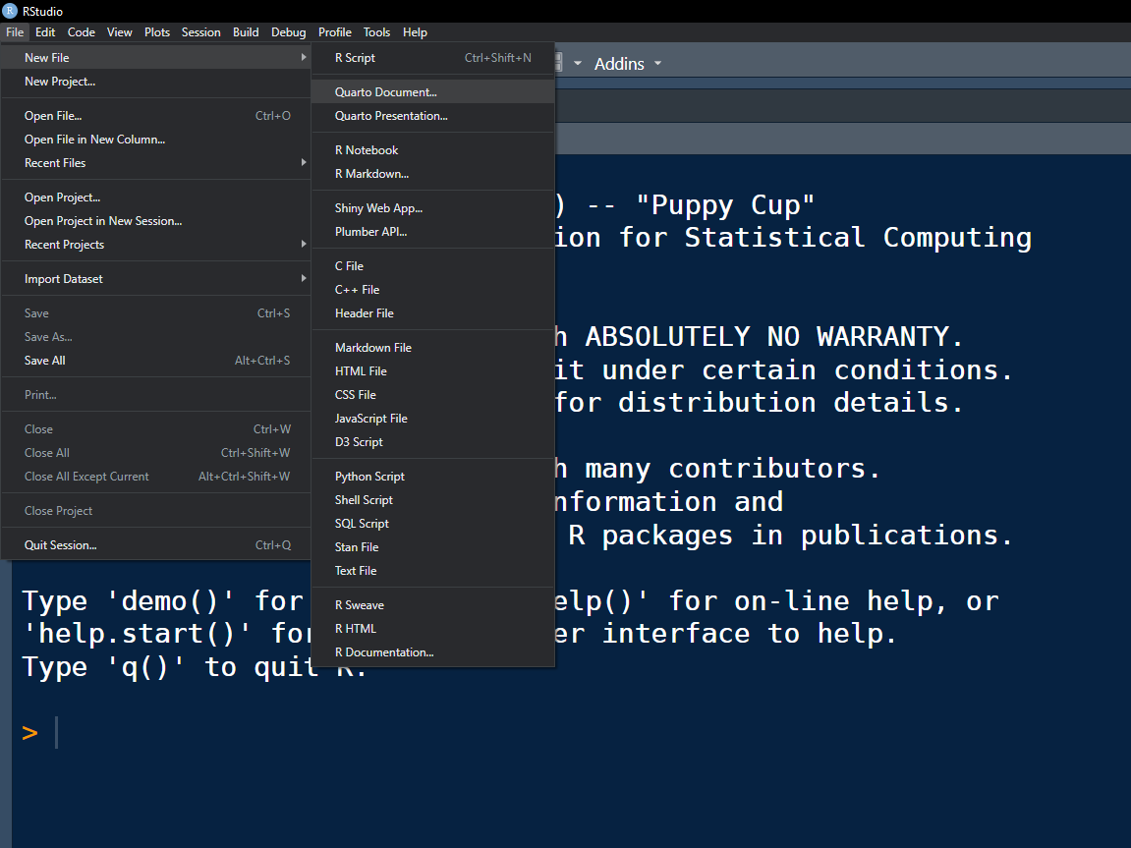
Creating reproducible reports
Quarto Document

Slide 4
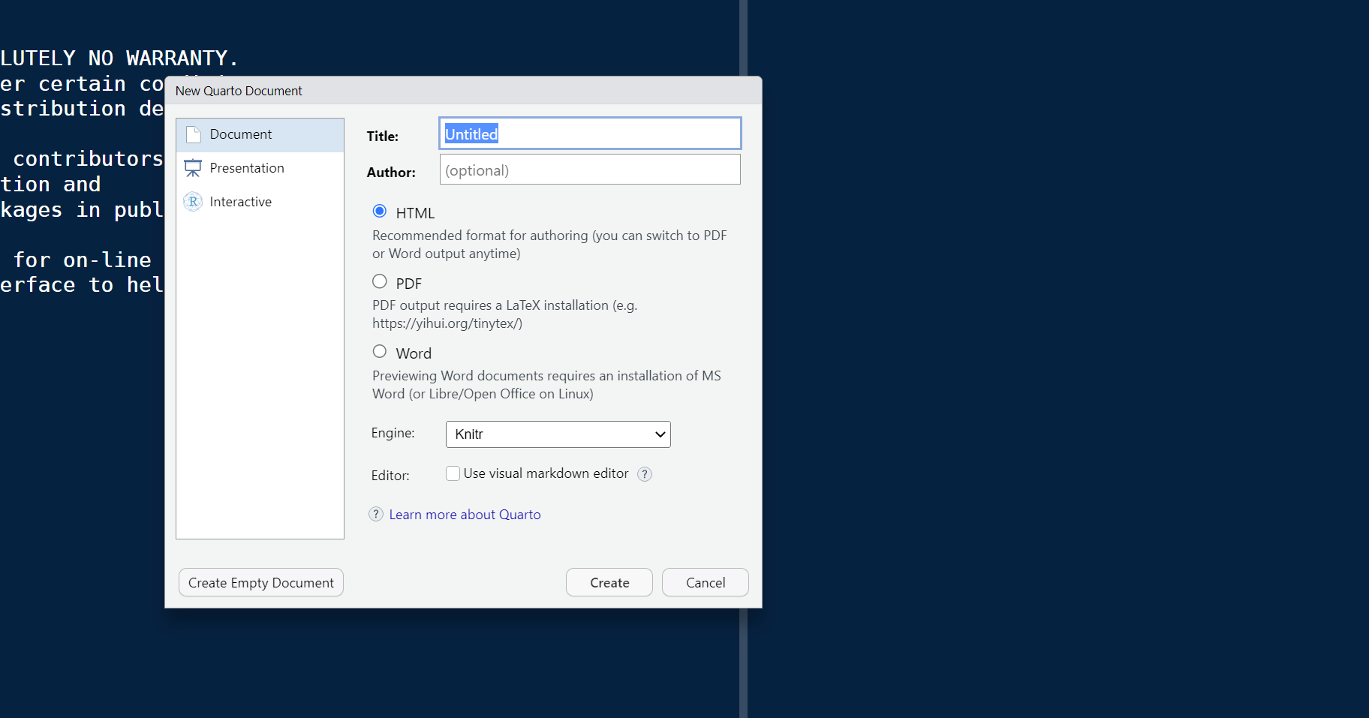
Creating reproducible reports
Several options
for output format
HTML is increasingly popular because it allows interactive graphics and tables.

Slide 5
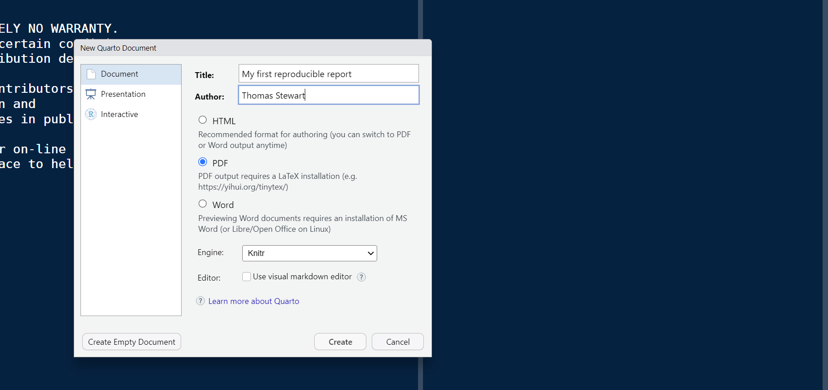
Creating reproducible reports
Report title
Report author
Because you will submit homework as PDF in Gradescope, we will start here.

Slide 6
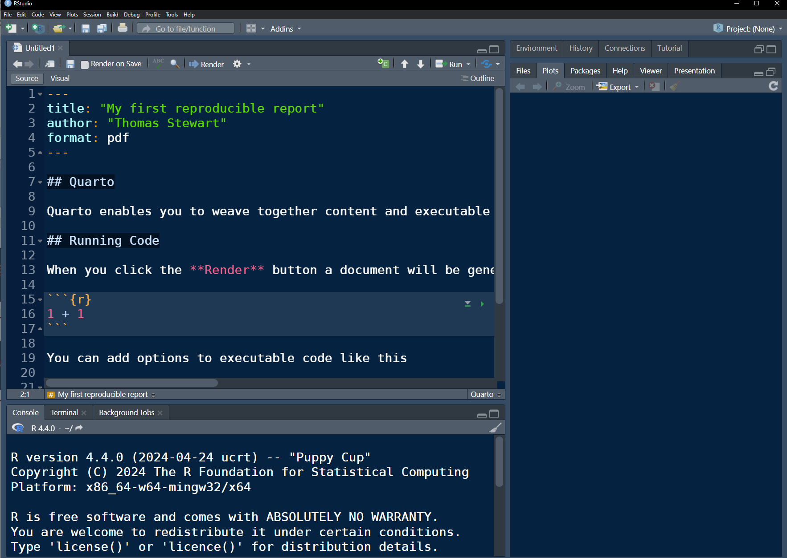
Source. This is where you will write code and commentary. A template document is automatically loaded.

Slide 7
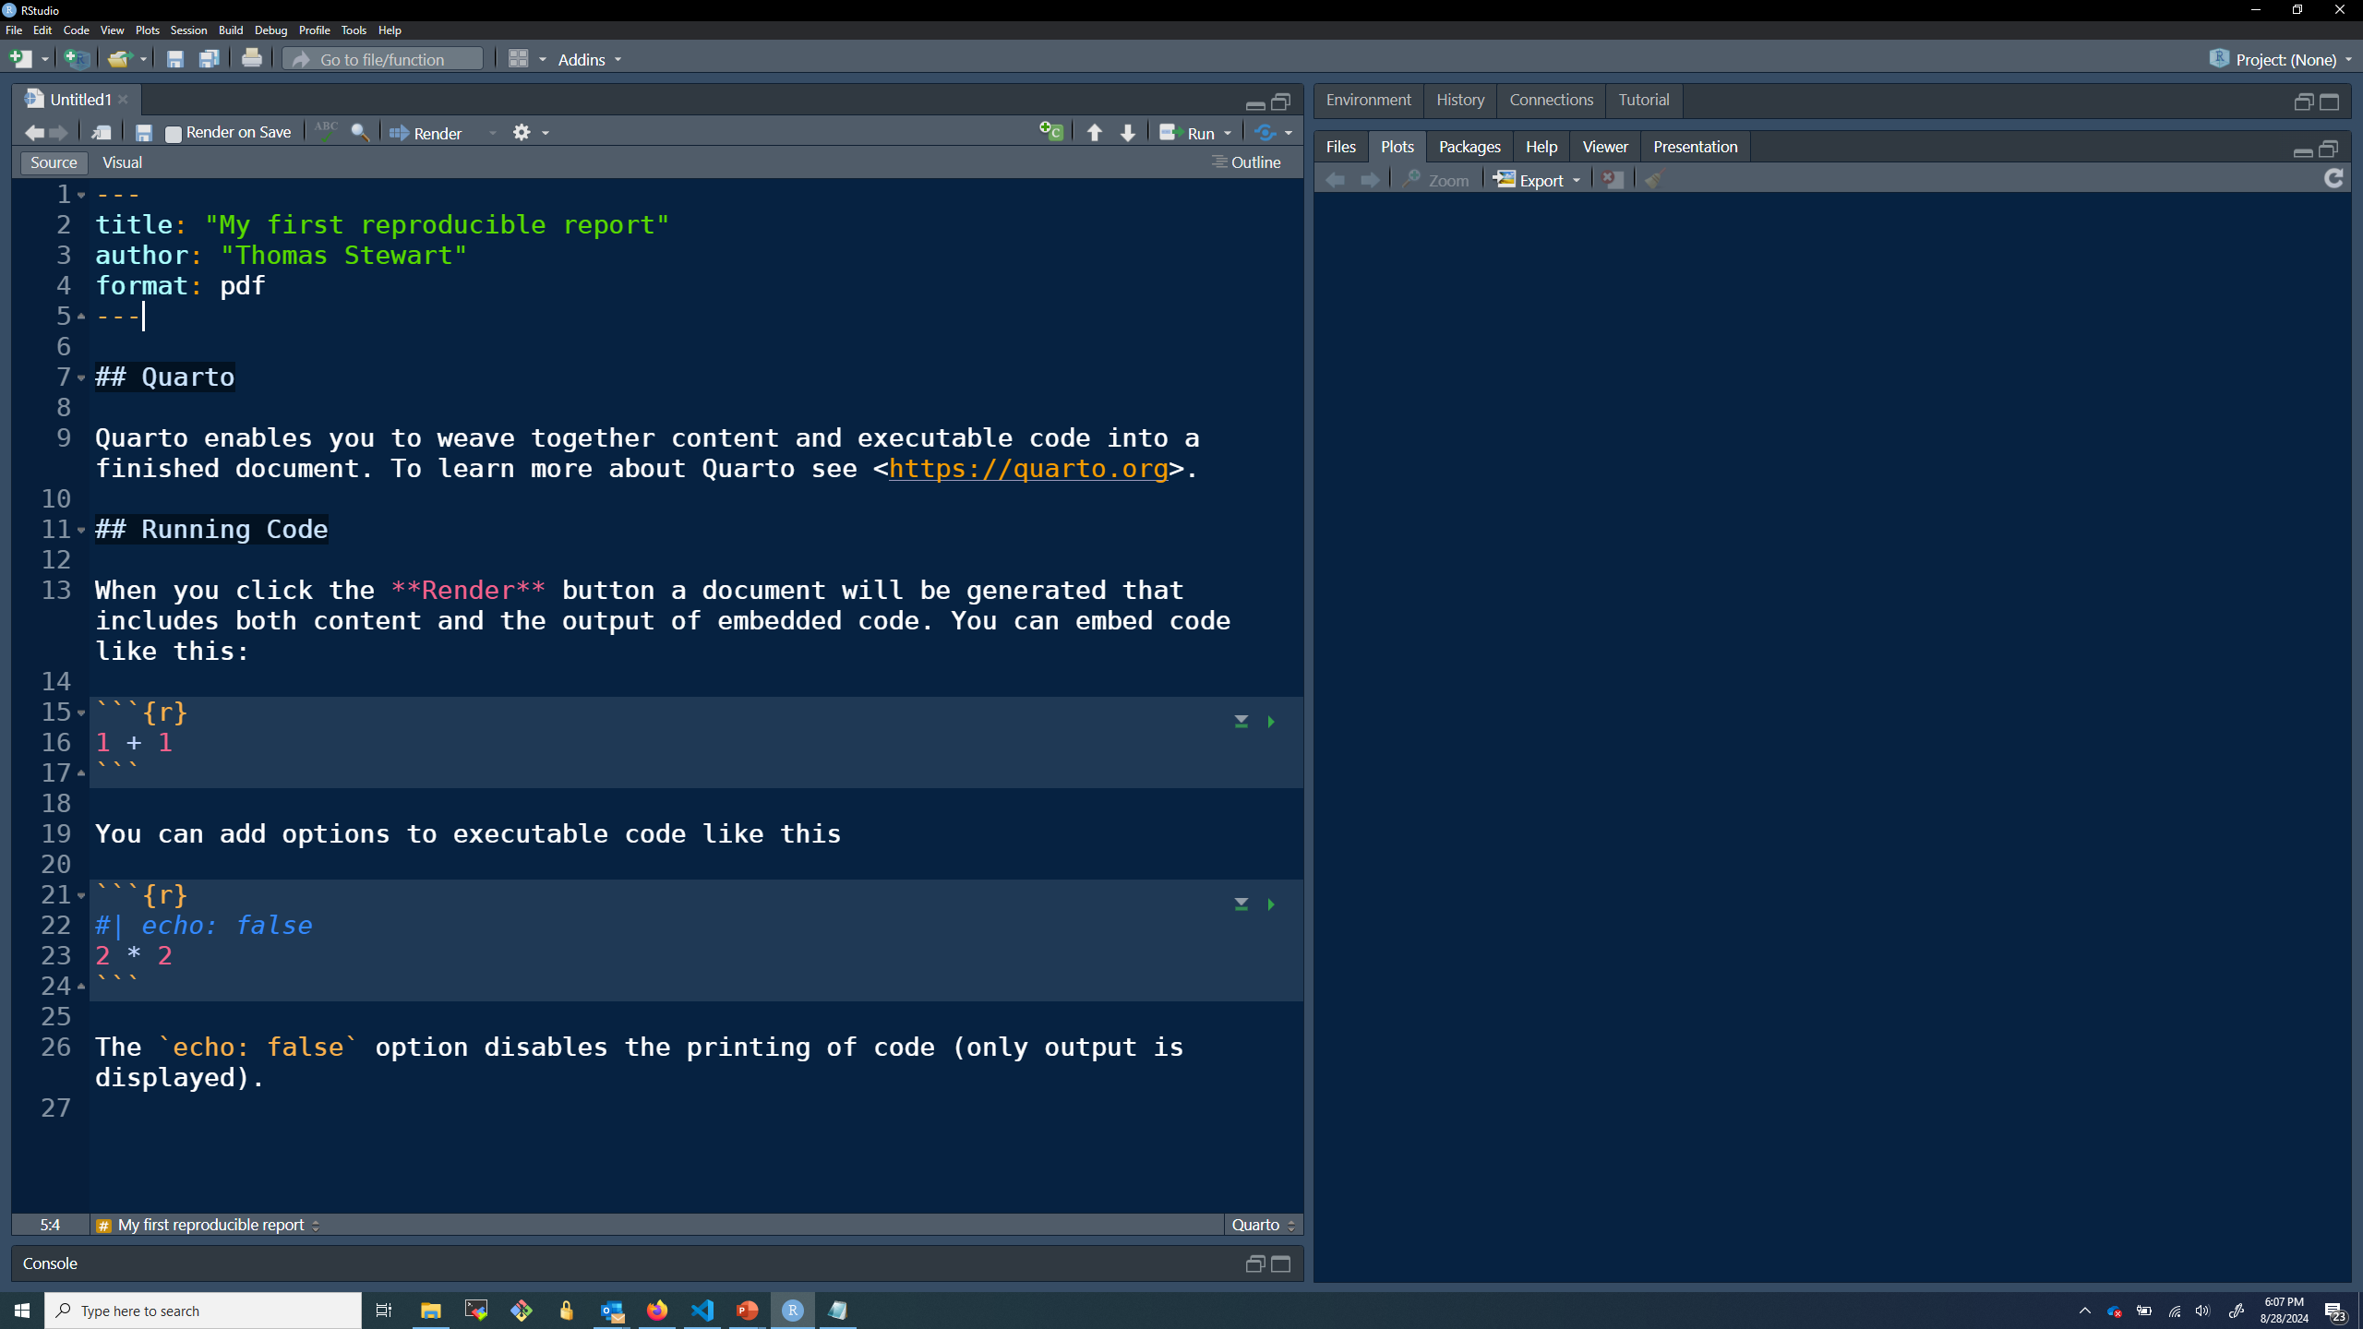
YAML header. Note the three dashes --- to mark the start and end. Information about the output format goes here.

Slide 8
Code chunk. Notice the 3 tick marks ``` which mark the start and end of the chunk. Commands to be executed in R go here. The code will also be included in the report.

Slide 9
Click the play button to execute the code in the chunk.

Slide 10
Click this button to execute the code in prior chunks (if any).

Slide 11
Code chunk. This code will be executed in R, but the code will not be included because of the option echo: false

Slide 12
Commentary, written with markdown formatting commands.
BOLD
HEADER
SEE LINK TO MARKDOWN FORMATTING CHEATSHEET
ON FINAL SLIDE

Slide 13
Console. This is where commands are executed.

Slide 14
Click to render the report. This will execute all the code and knit the code, output, and commentary together into a single document.

Slide 15
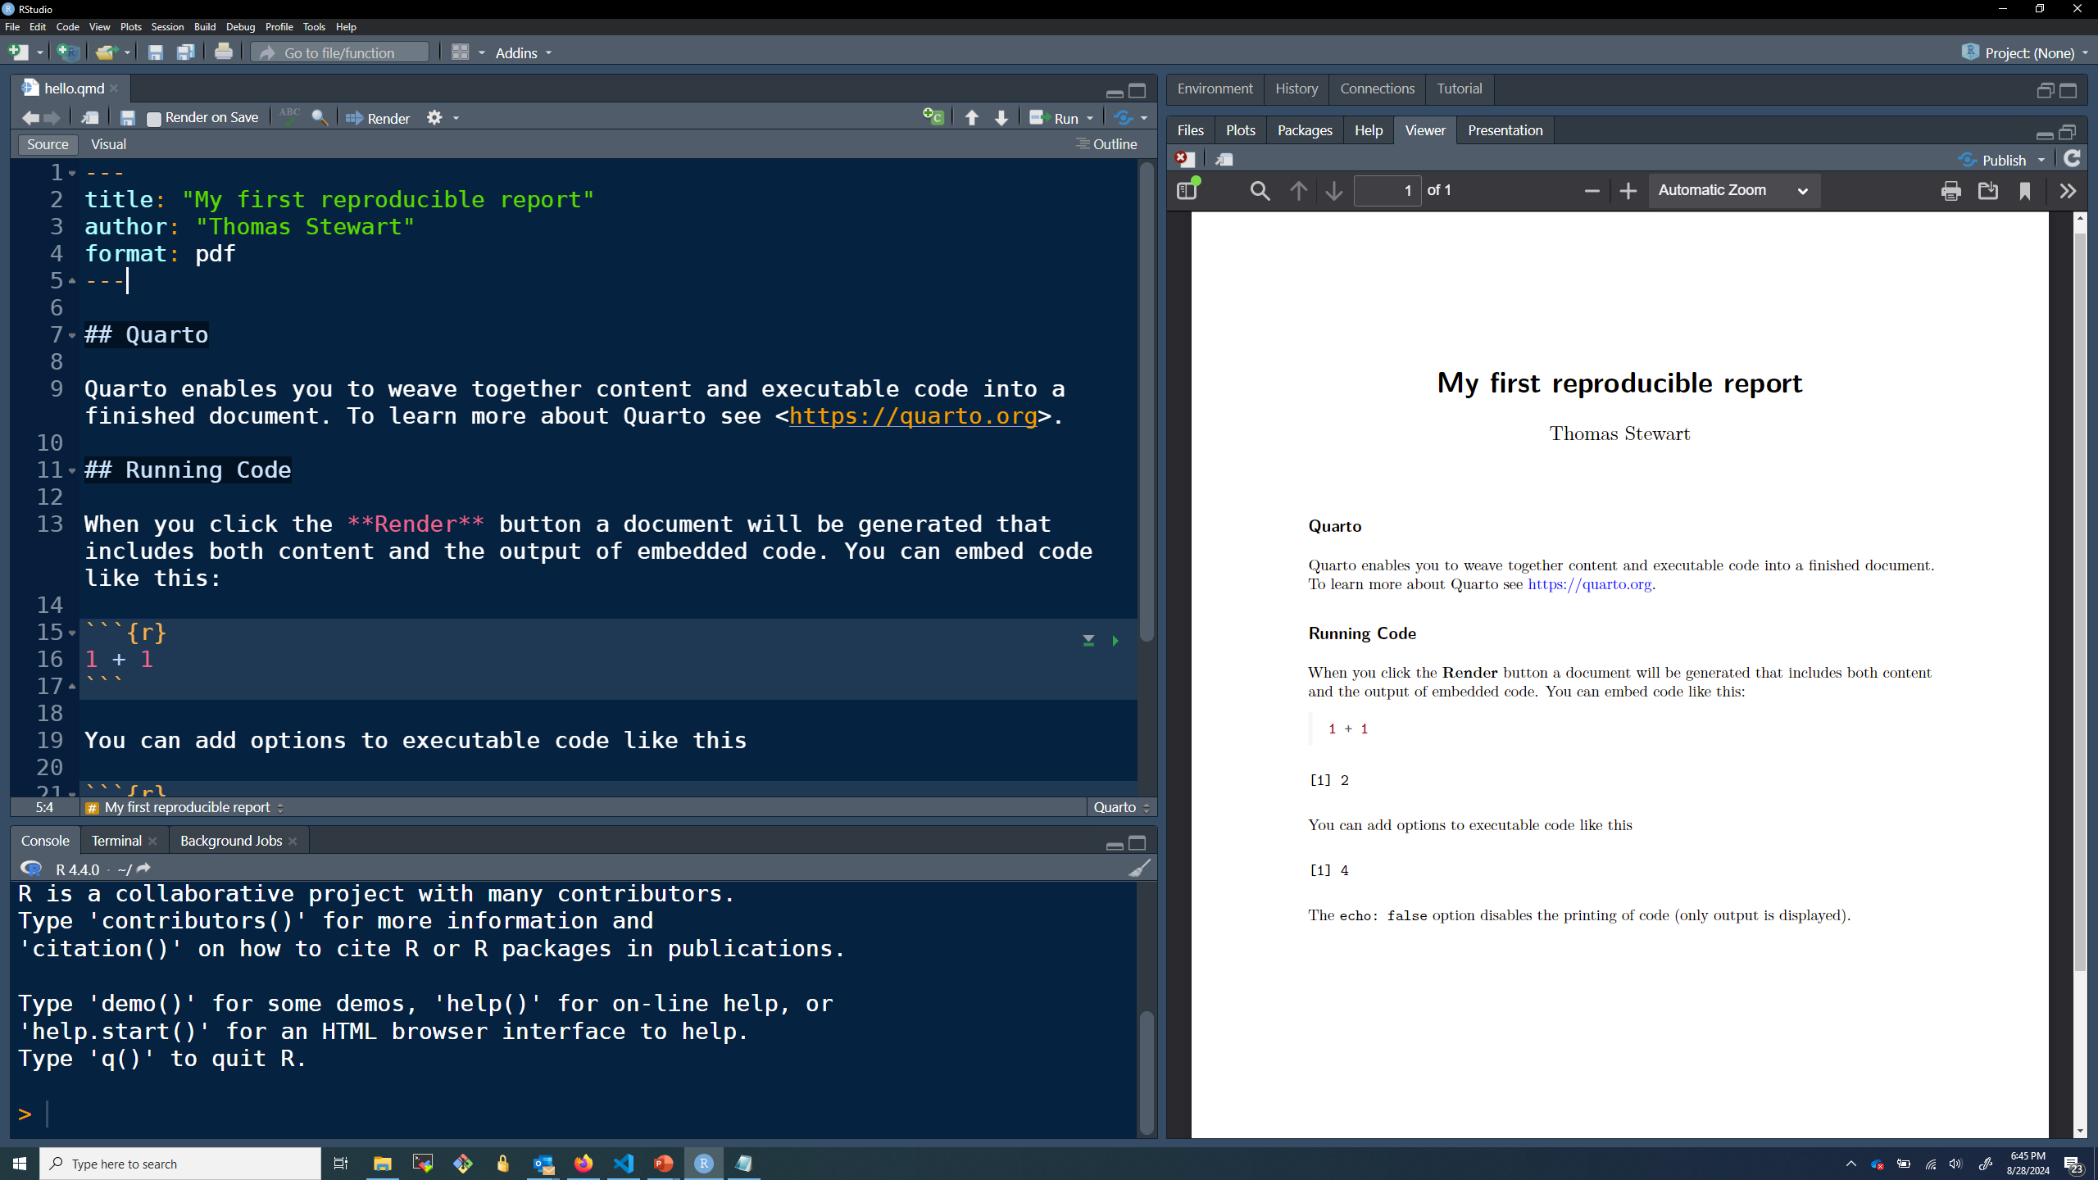
Reproducible report with formatted commentary, code, and output.

Slide 16
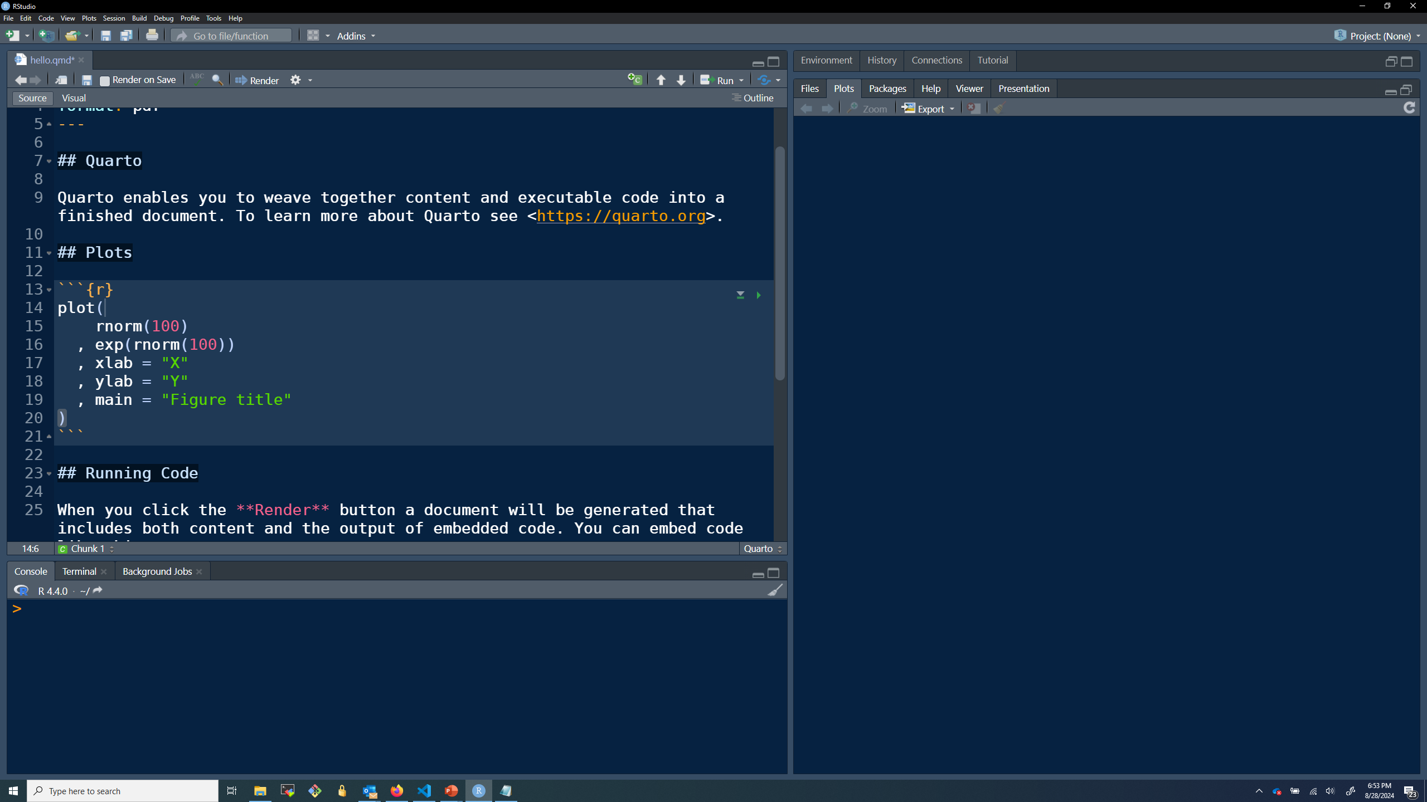
Can add commands to create plots.

Slide 17
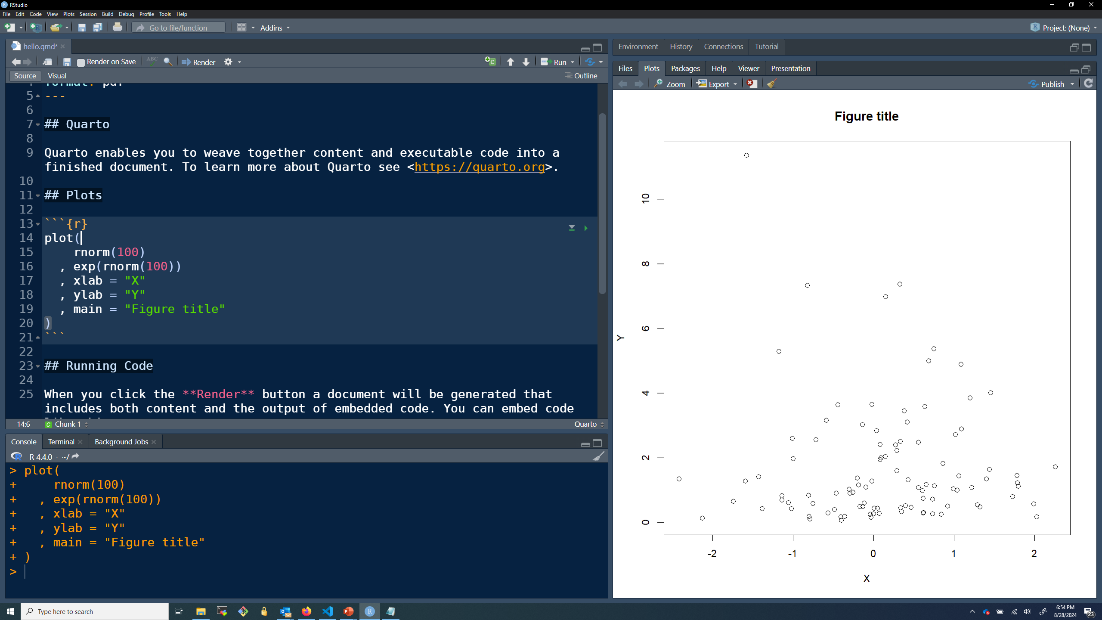
Can preview figure in the plot viewer.

Slide 18
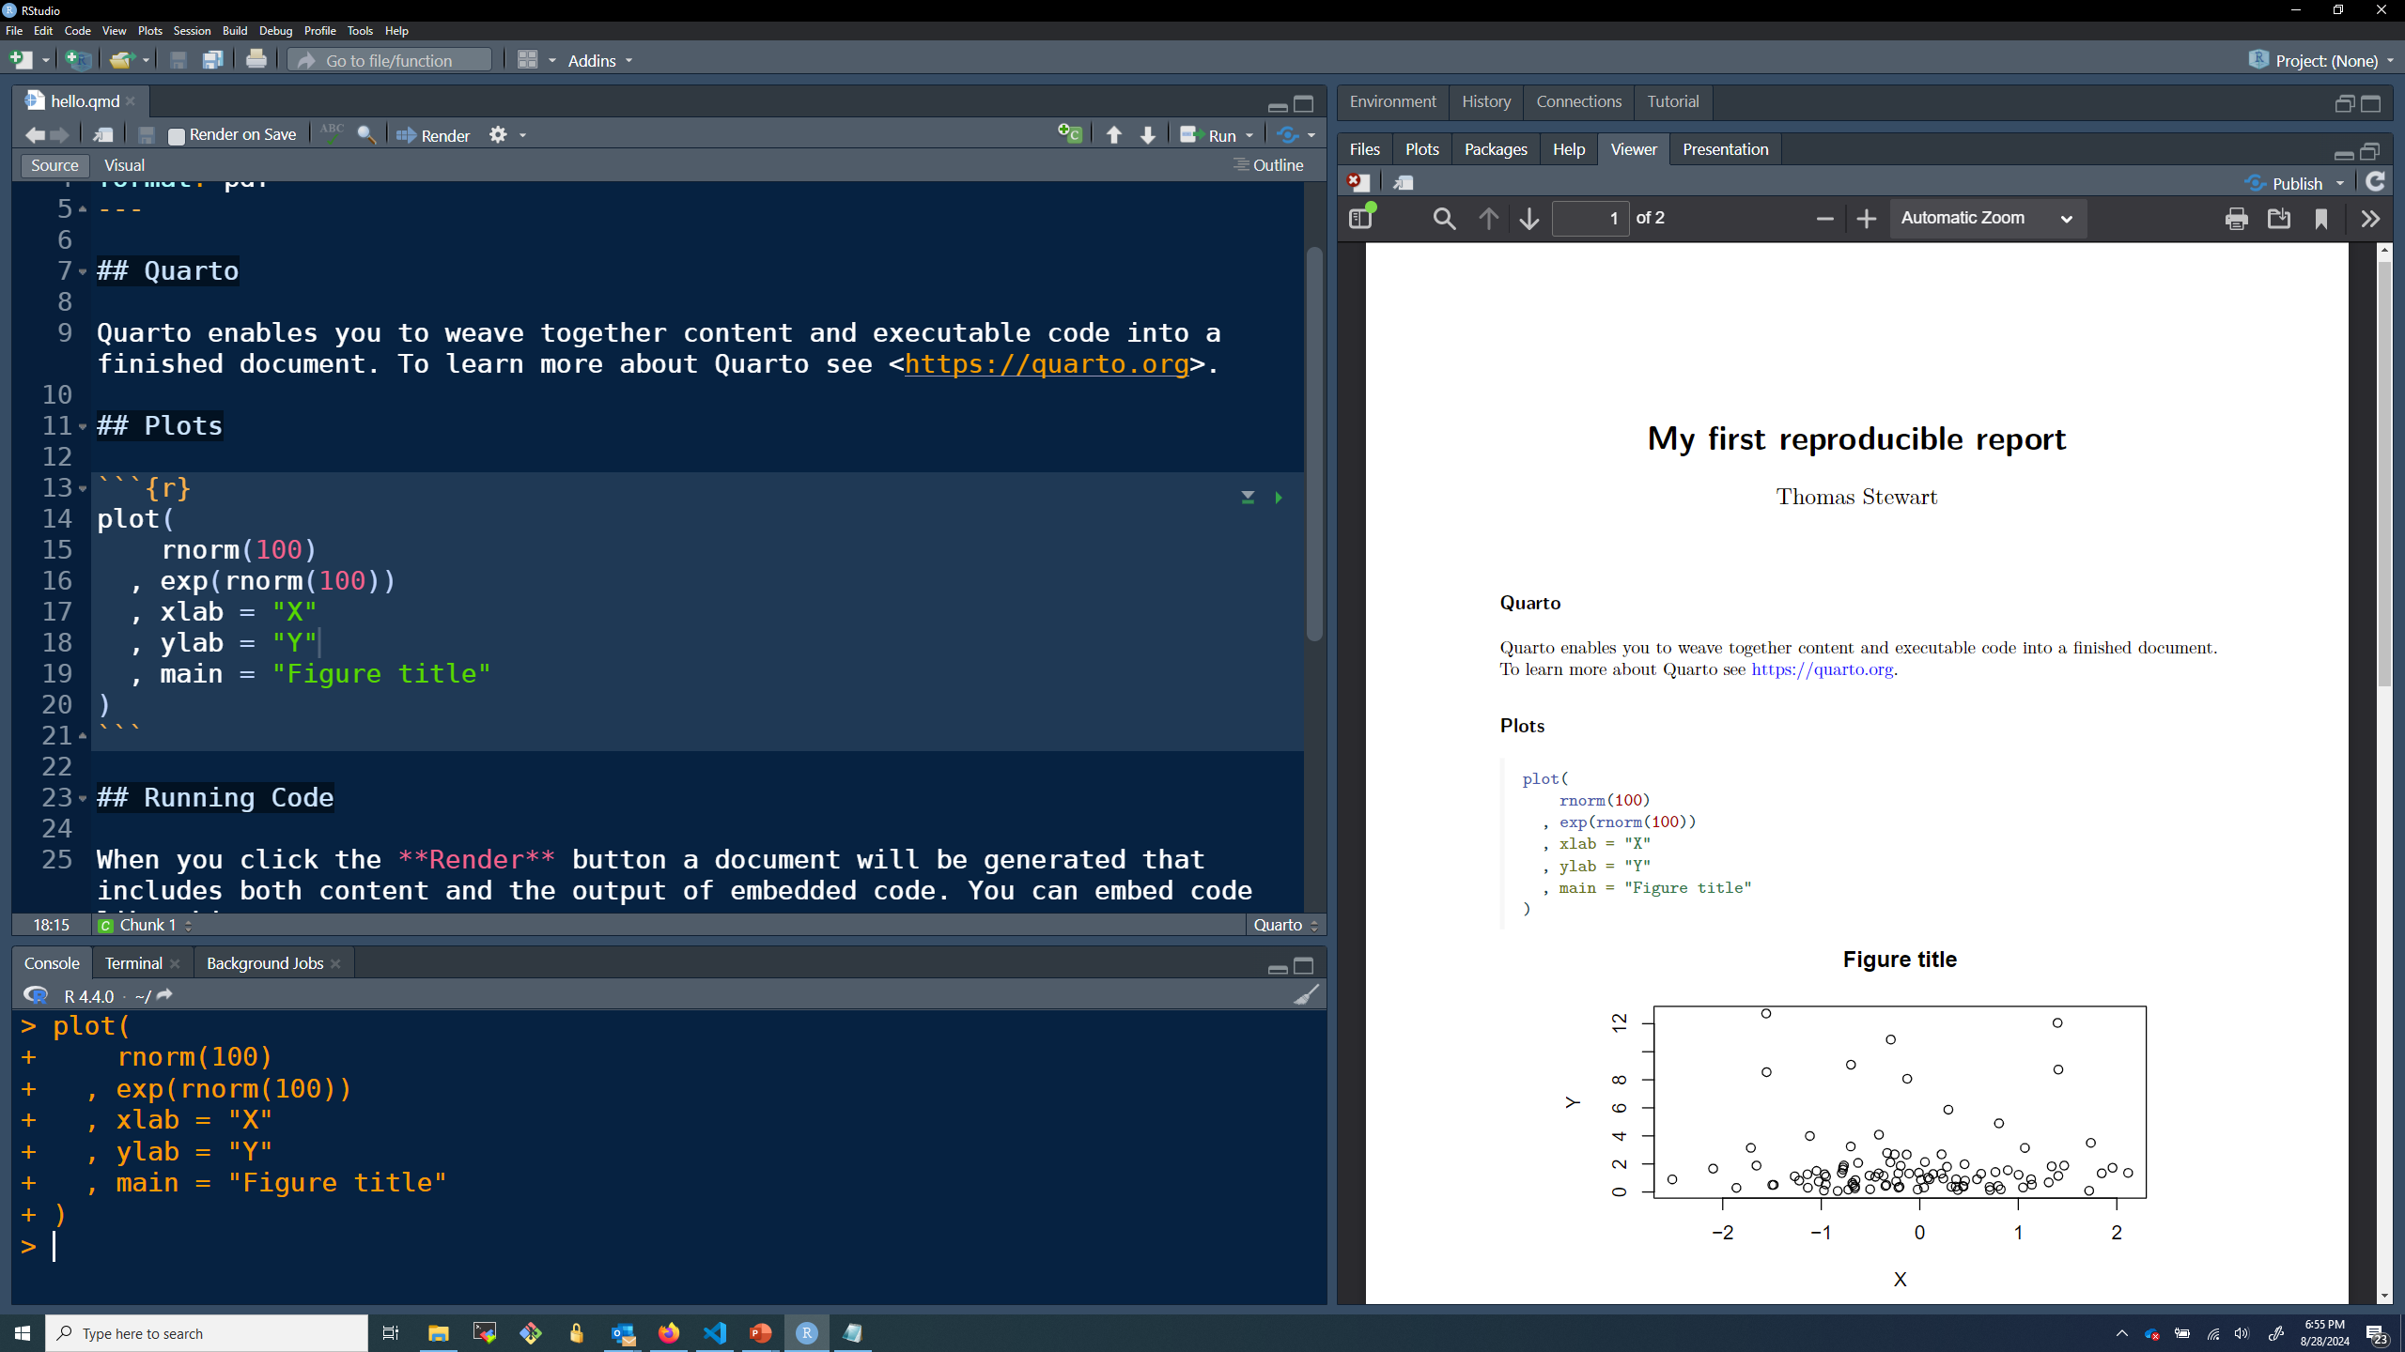
Re-render report to include figure.

Slide 19
Submitting your assignments in Gradescope
The easiest way to submit your homework in Gradescope is to format your document so that each question is on its own page.
You can achieve this in your pdf reproducible report with the \newpage command.

Slide 20
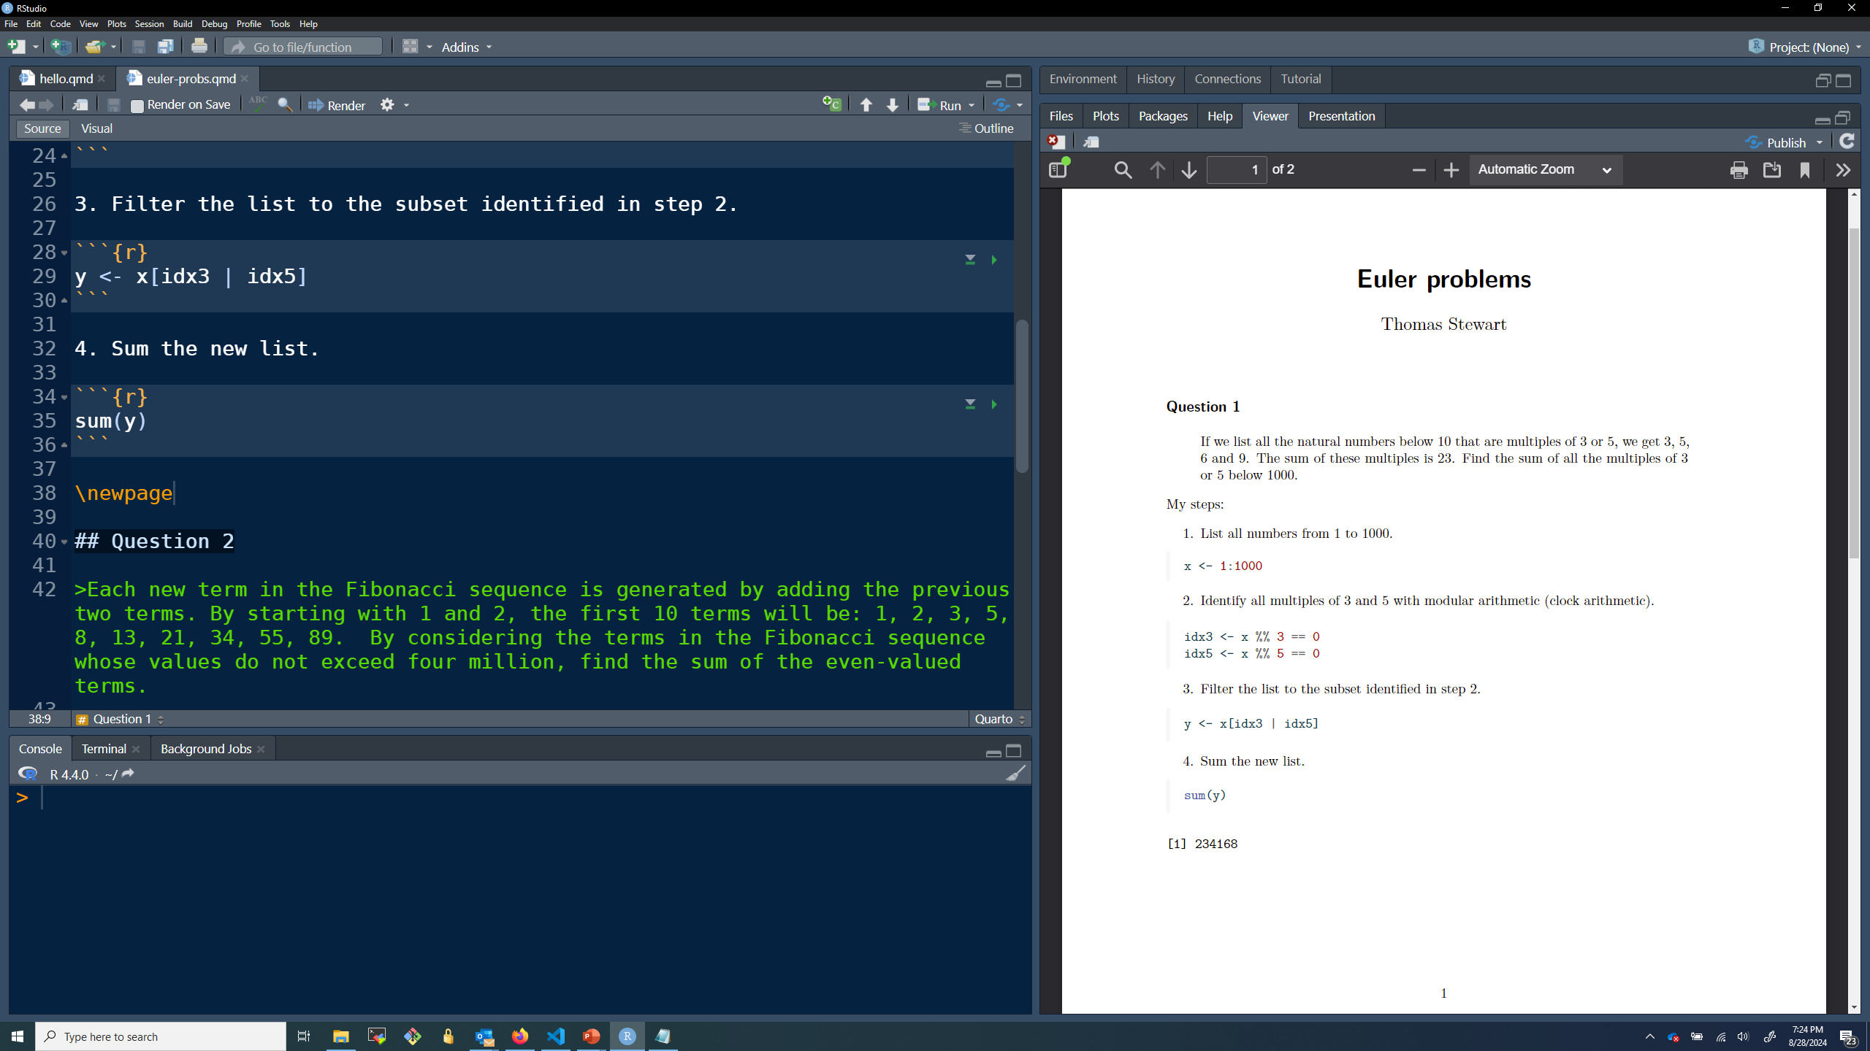
Page break

Slide 21
It is often helpful to add mathematical notation
This can be achieved with Latex

Slide 22
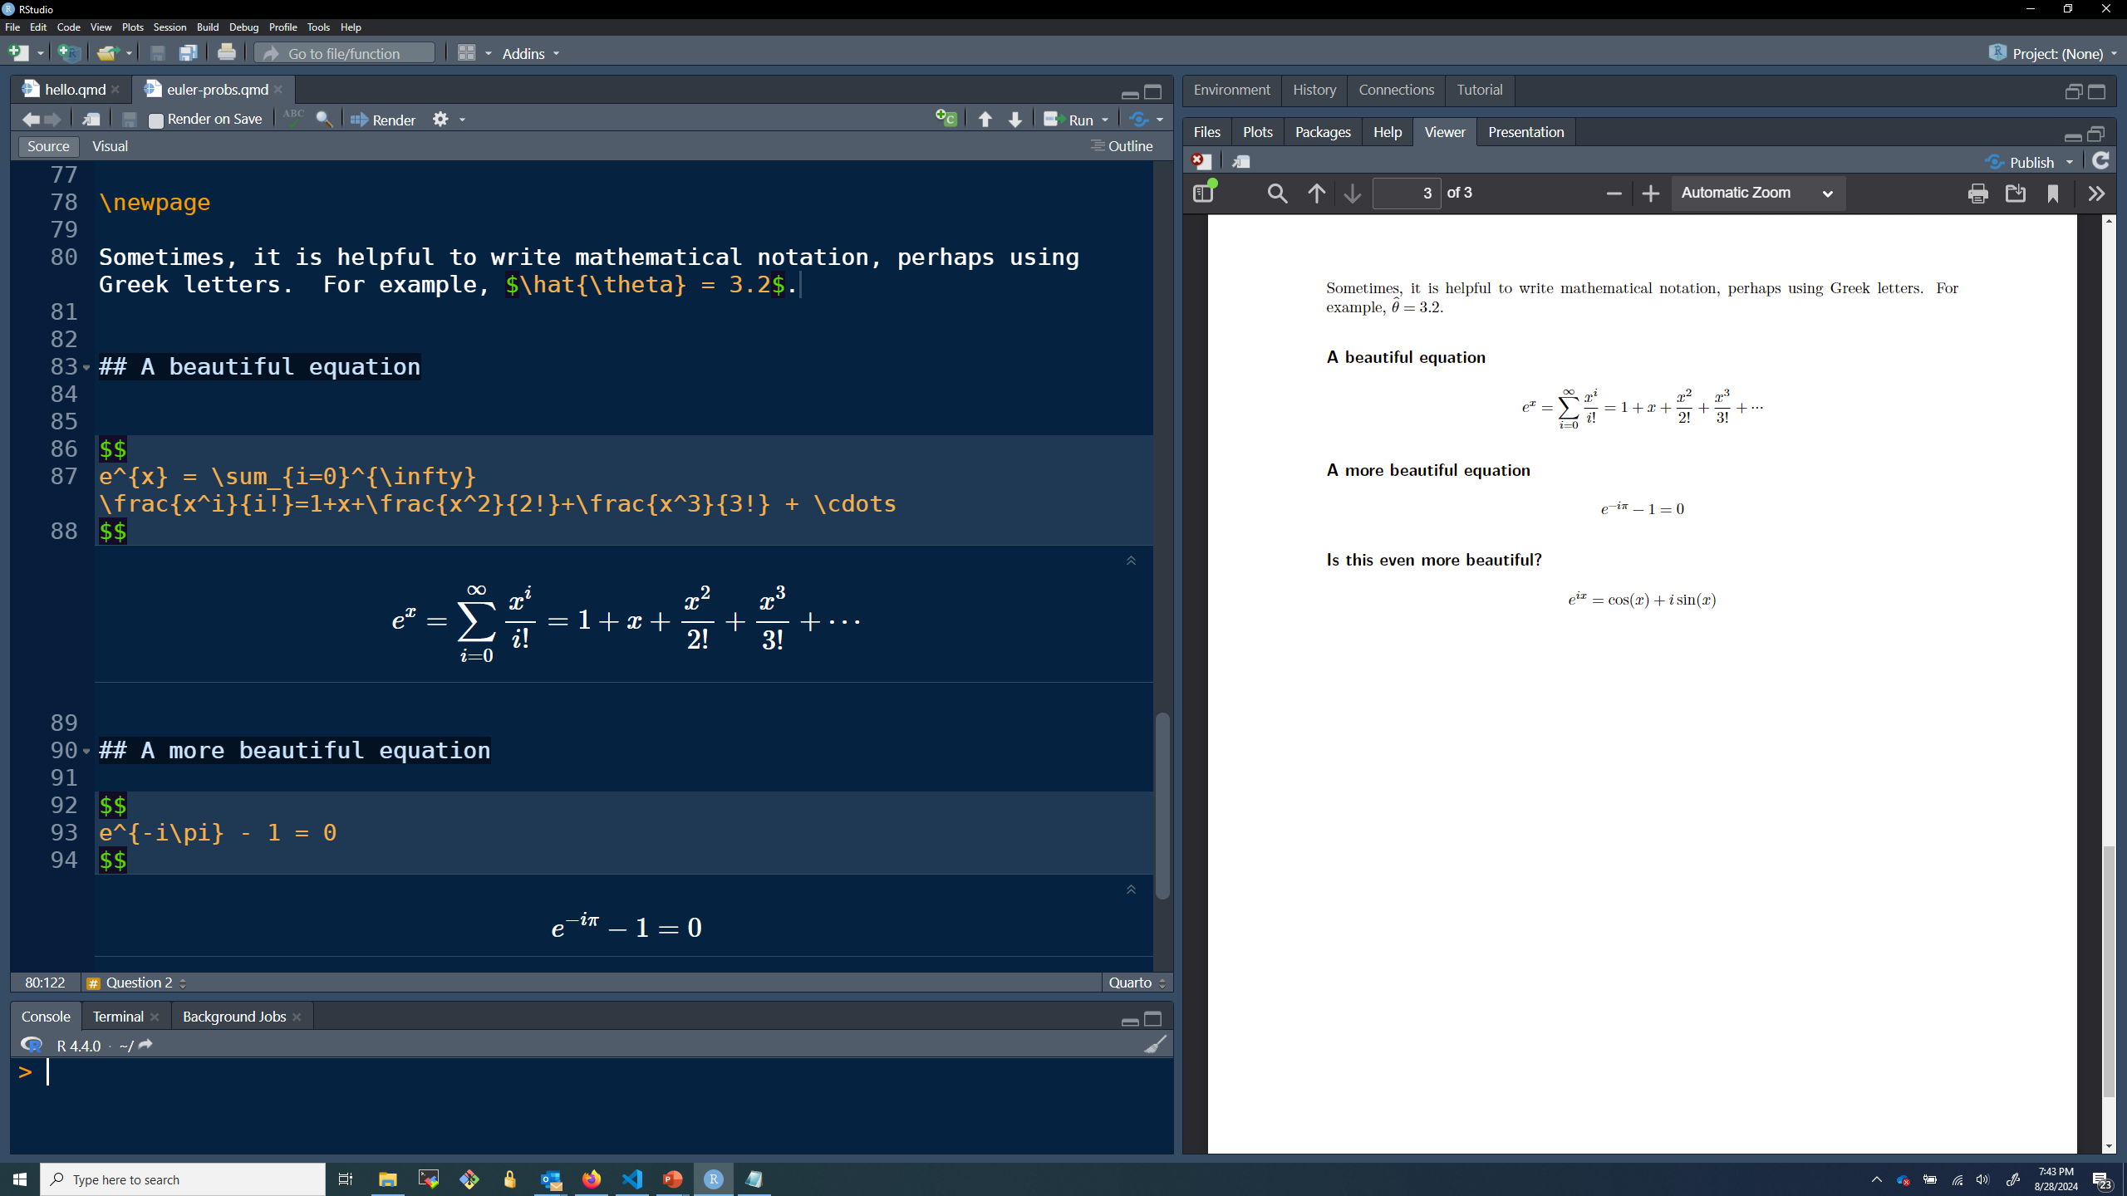
Inline math w/ single $
Math chunks w/ double $$

Slide 23
There are lots of online resources for reproducible reports
Hello Quarto (Getting started guide) (link)
Mathematics in R Markdown (link)
Getting started with Markdown (link)

