Slide 1
Getting up and running in R

Slide 2
R
Rivanna (Cloud)
On your personal computer (local)
Web based interface to R through Rstudio Server
Desktop application
Standalone
Integrated development environment
VS Code
Rstudio

Slide 3
Rivanna
Rivanna is the University of Virginia’s High-Performance Computing (HPC) system.
As a centralized resource it has hundreds of pre-installed software packages available for computational research across many disciplines.
Currently the Rivanna supercomputer has 603 nodes with over 20476 cores and 8PB of various storage.

Slide 4
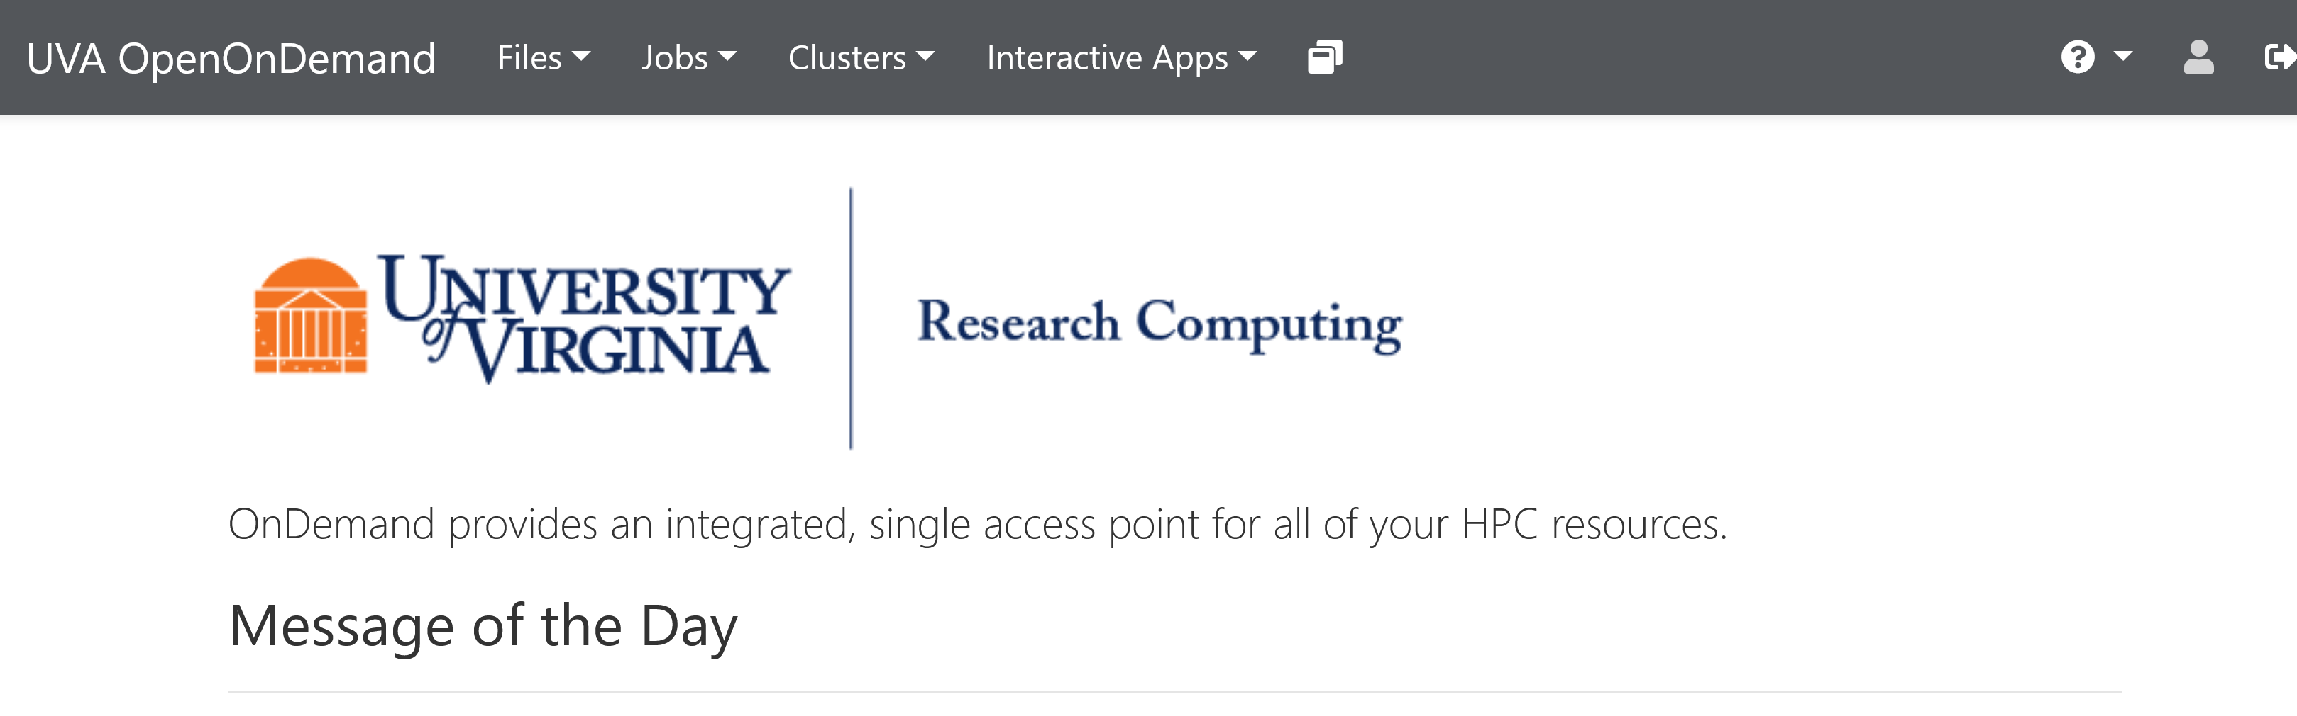
Rivanna (cloud based computing)
Login: https://rivanna-portal.hpc.virginia.edu/
Requires UVA credentials
After login, click interactive apps and select Rstudio Server

Slide 5
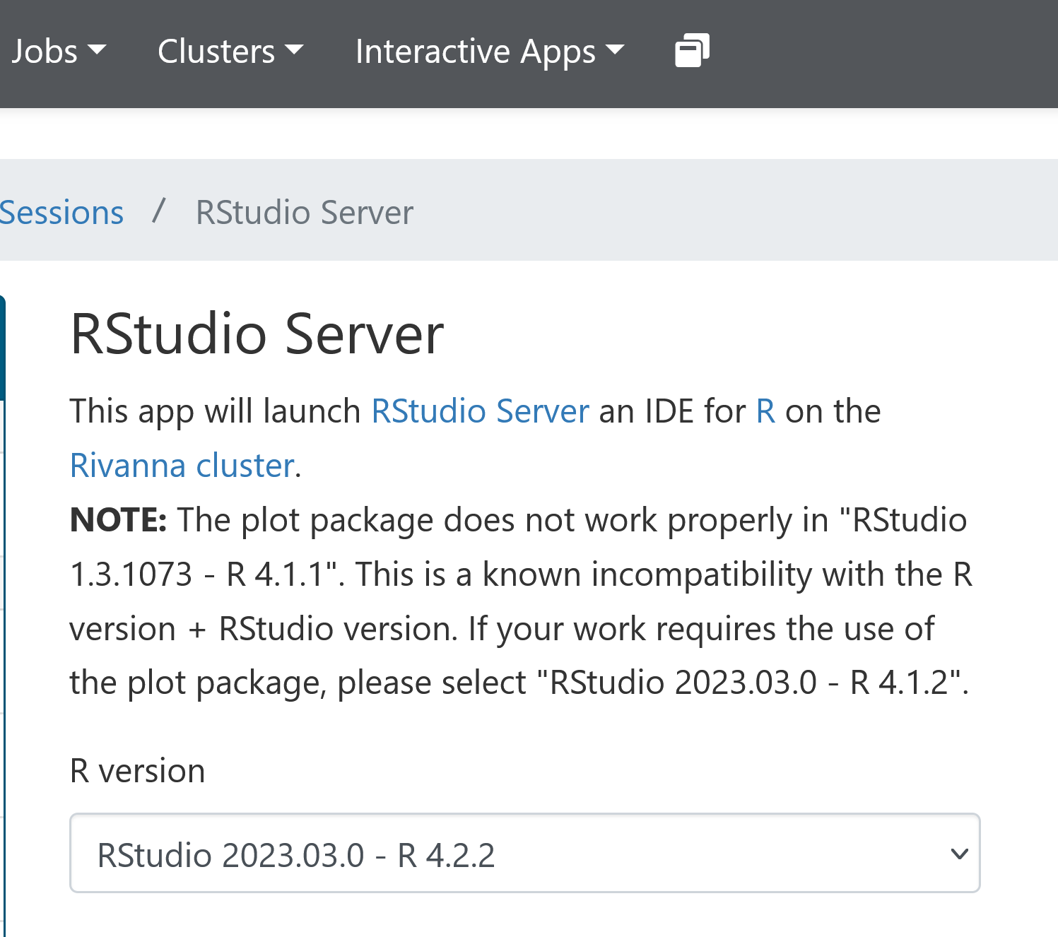
Rivanna
Select the most recent version of R

Slide 6
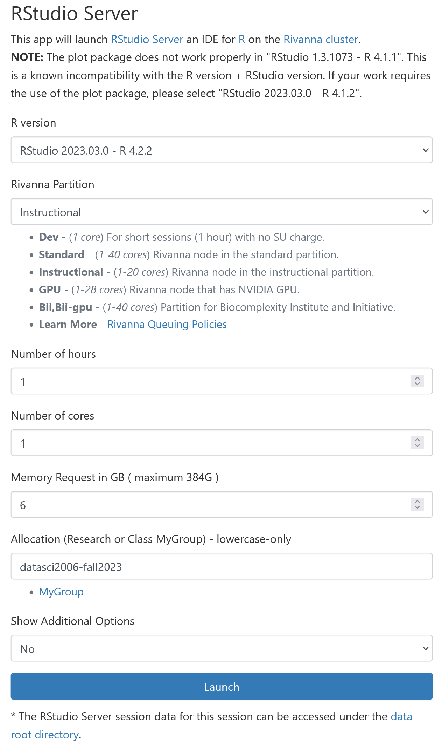
Rivanna
These are options for how much compute power and memory to allocate. In later examples, we will change these to match our project needs. Today, the minimums are fine.
This is the account to use for this class
ds2026-fall2024

Slide 7
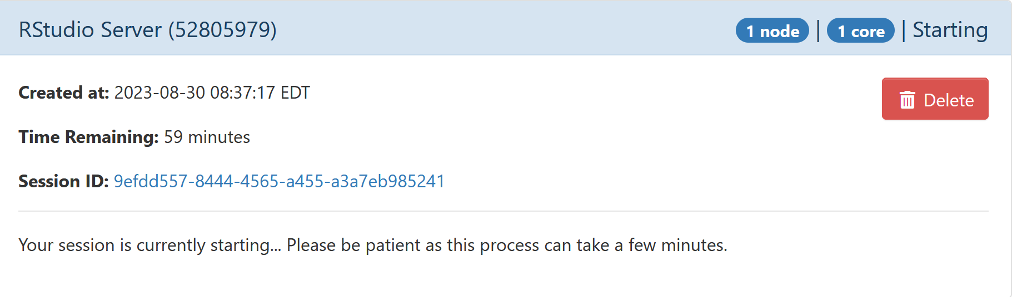
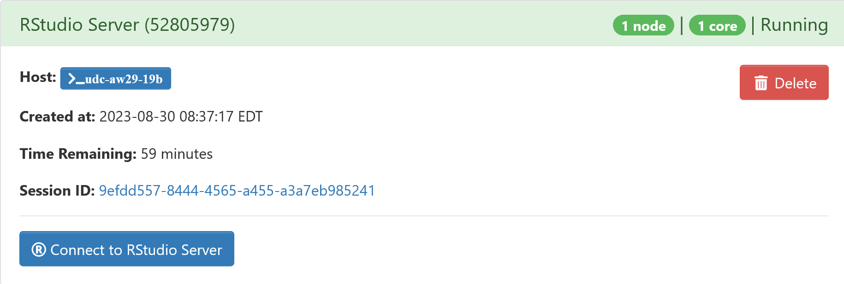
Rivanna

Slide 8
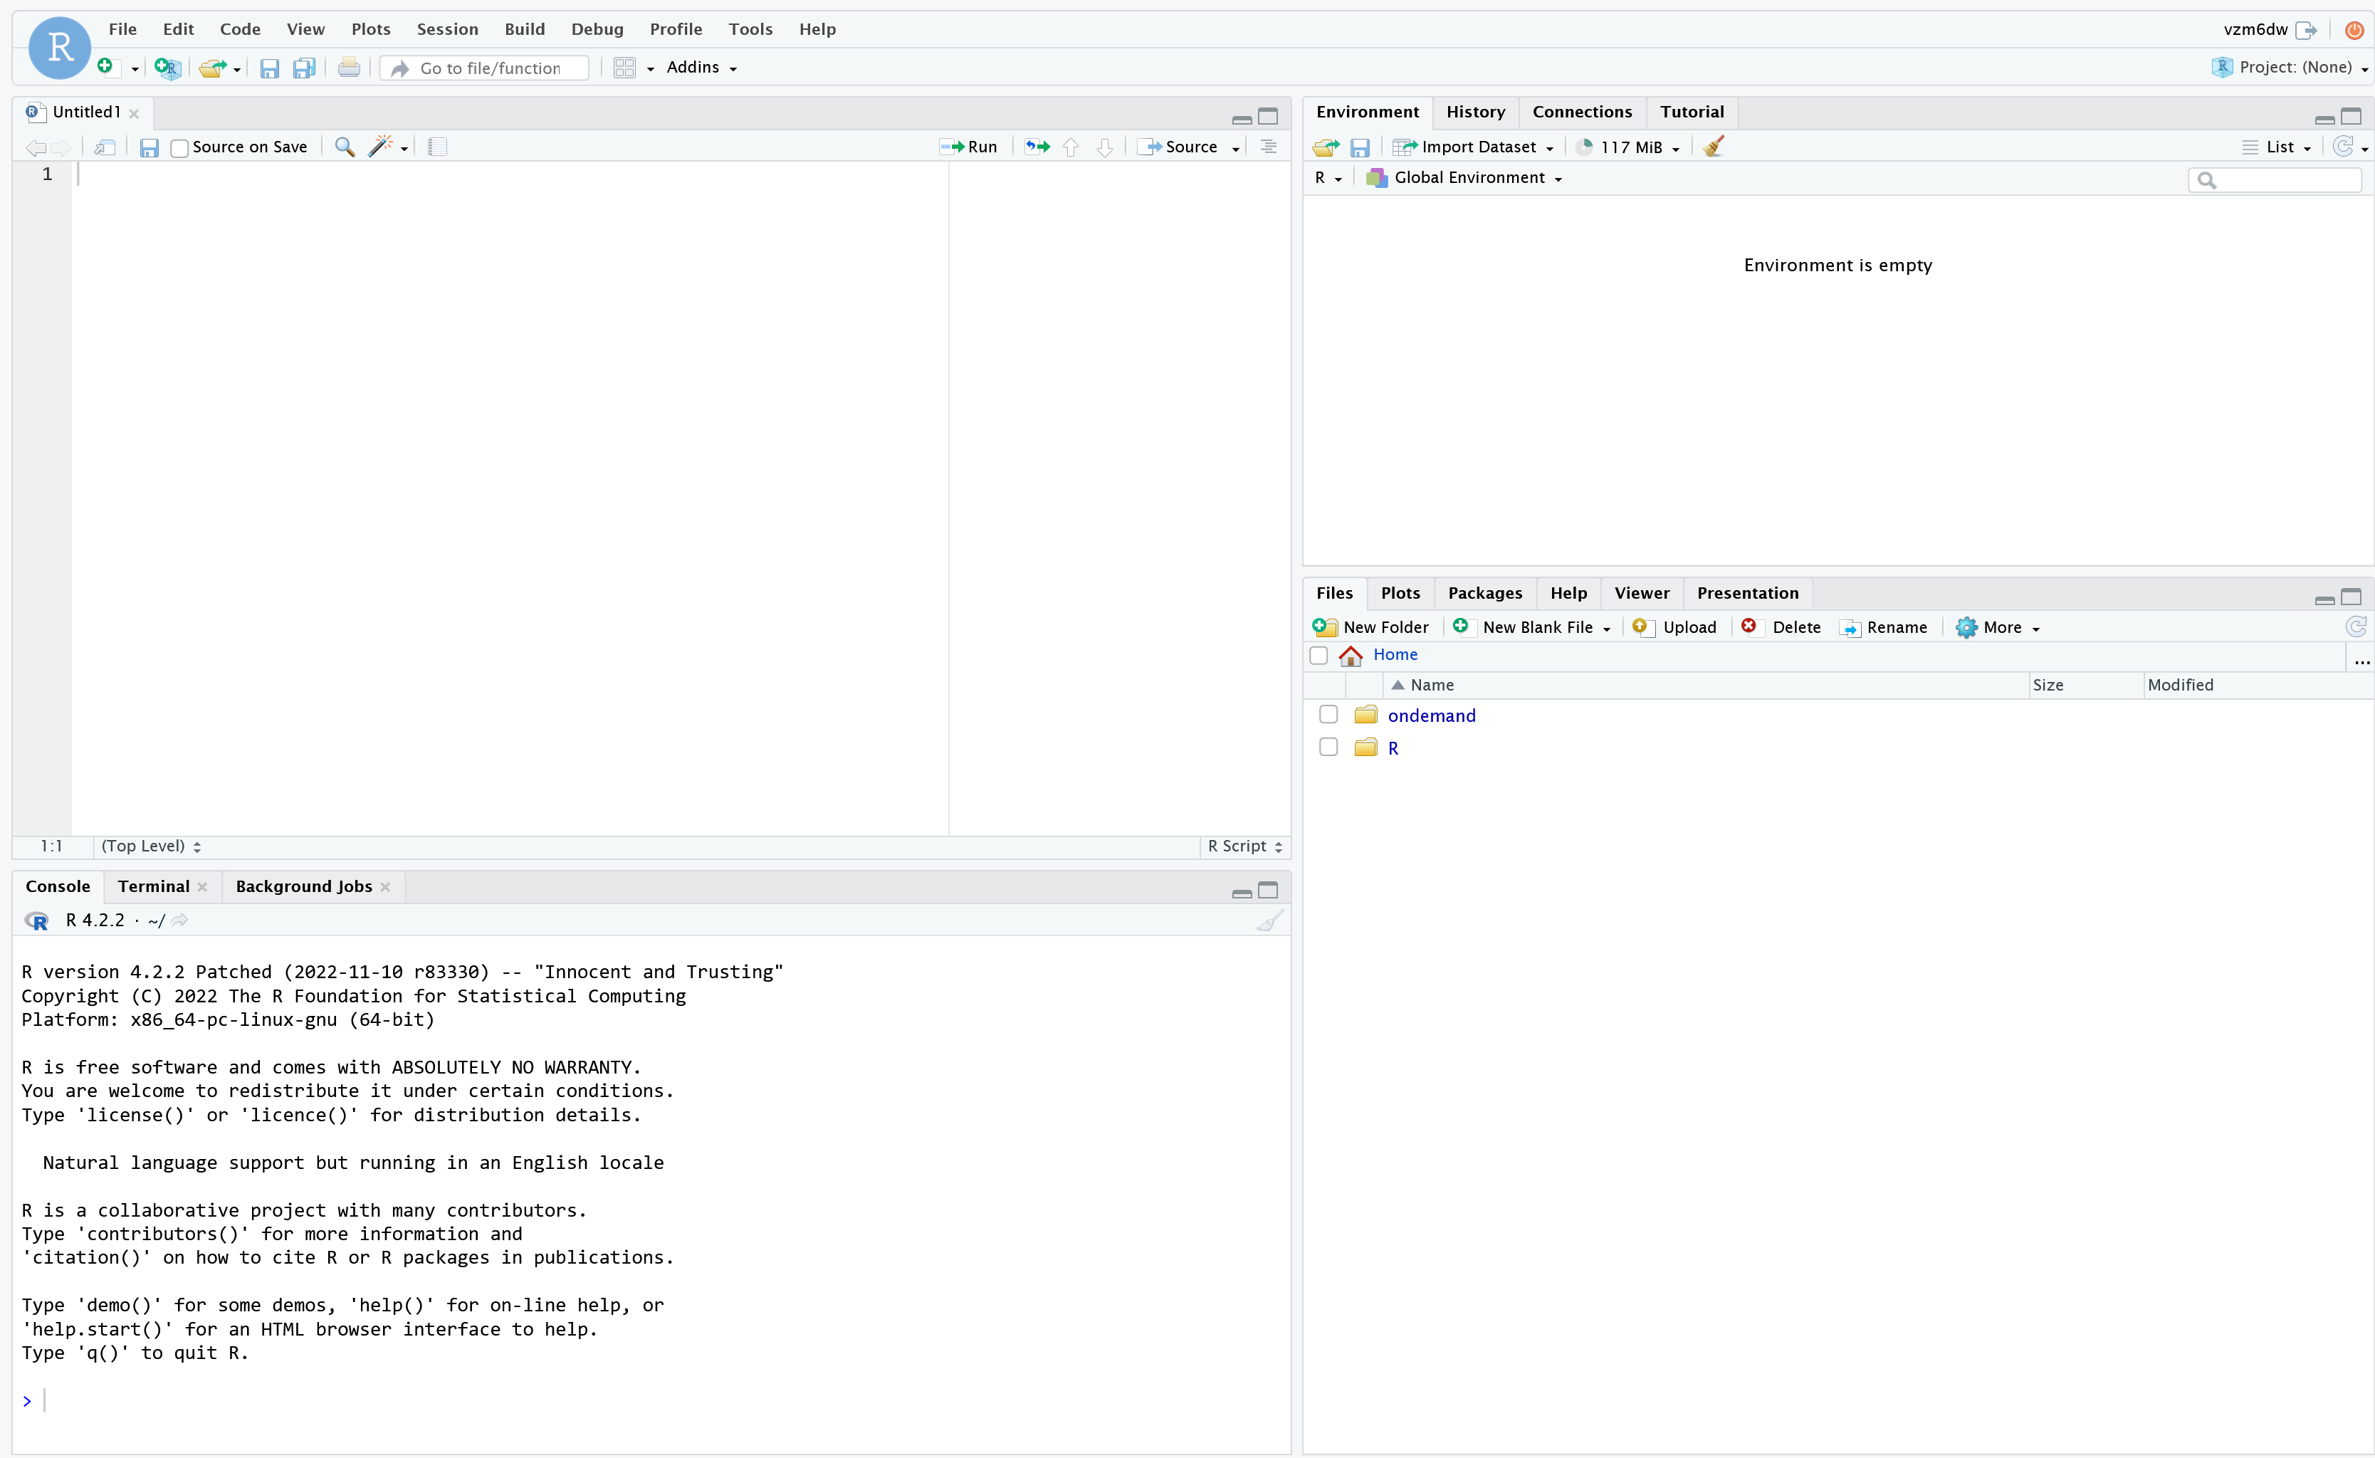

Slide 9
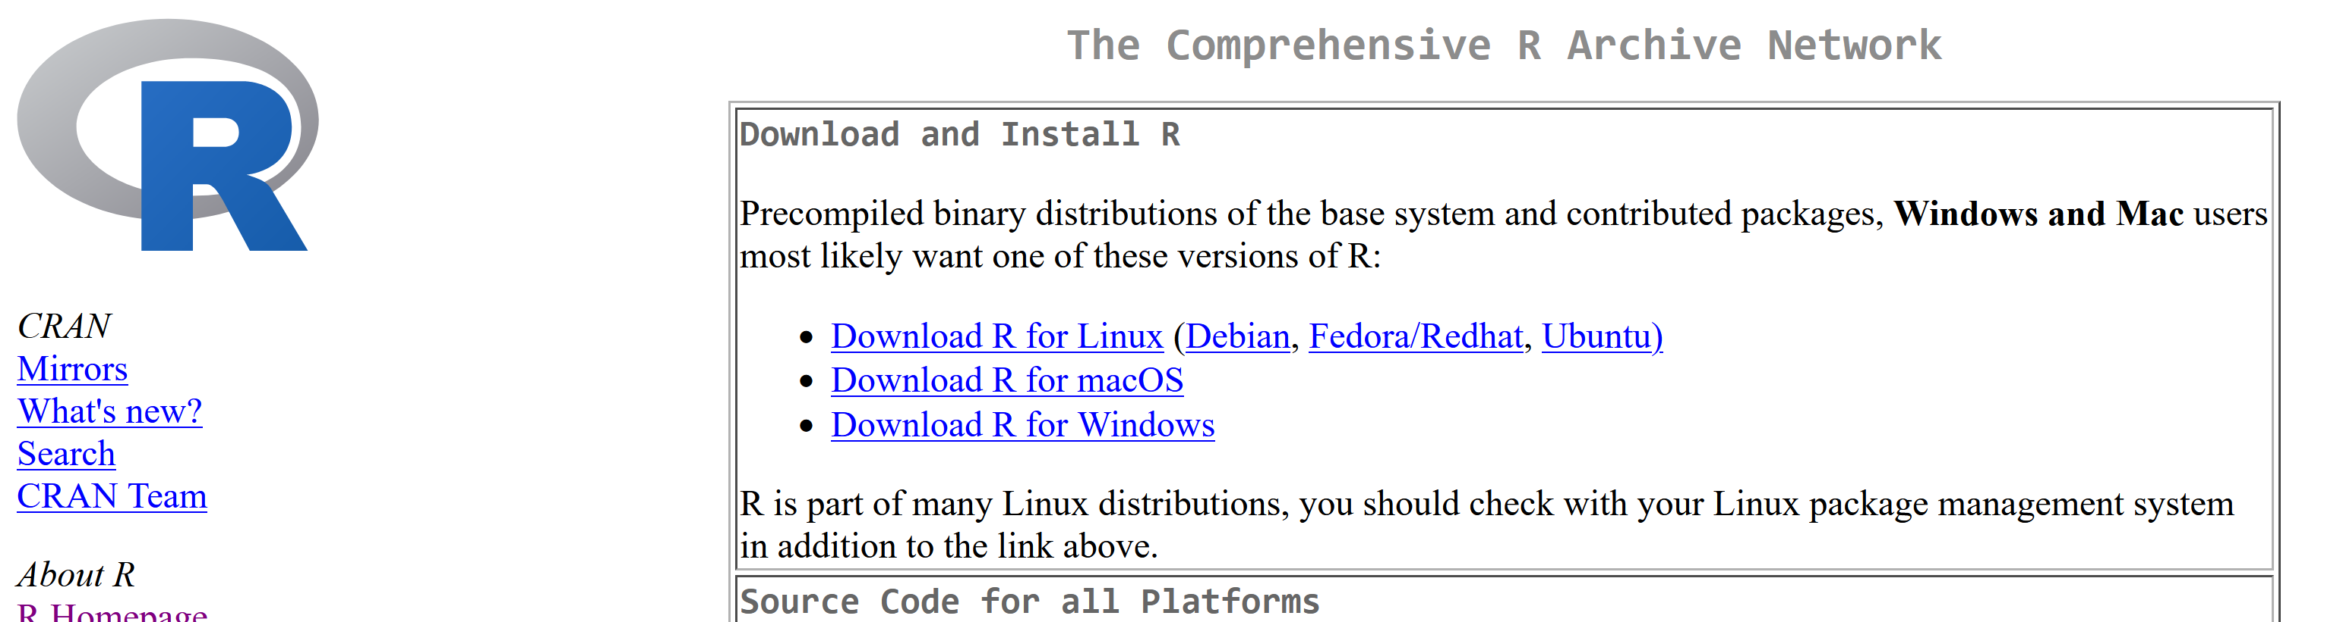
Desktop application
https://cloud.r-project.org/

Slide 10
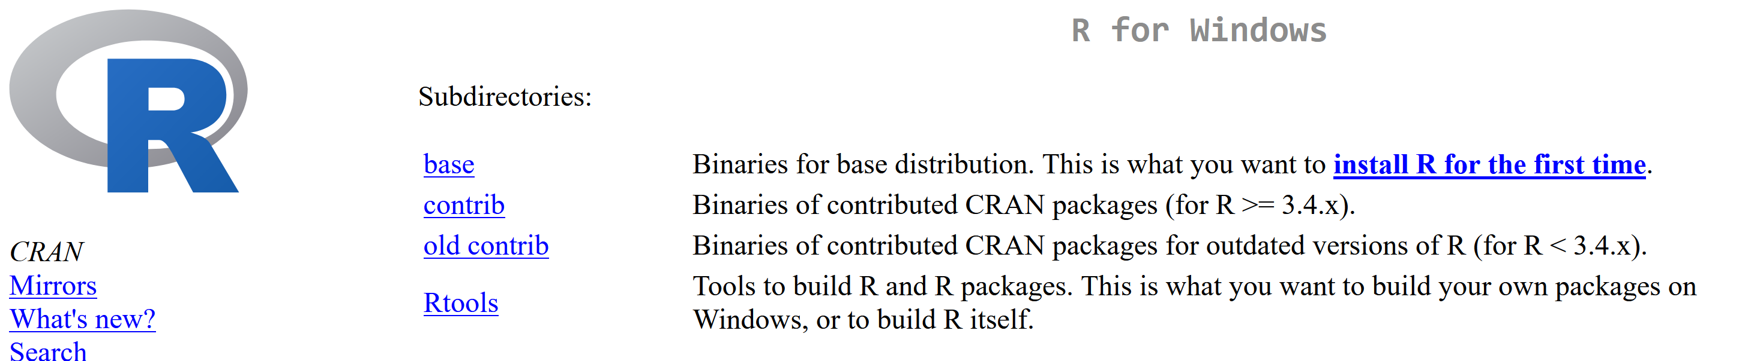
Desktop application

Slide 11
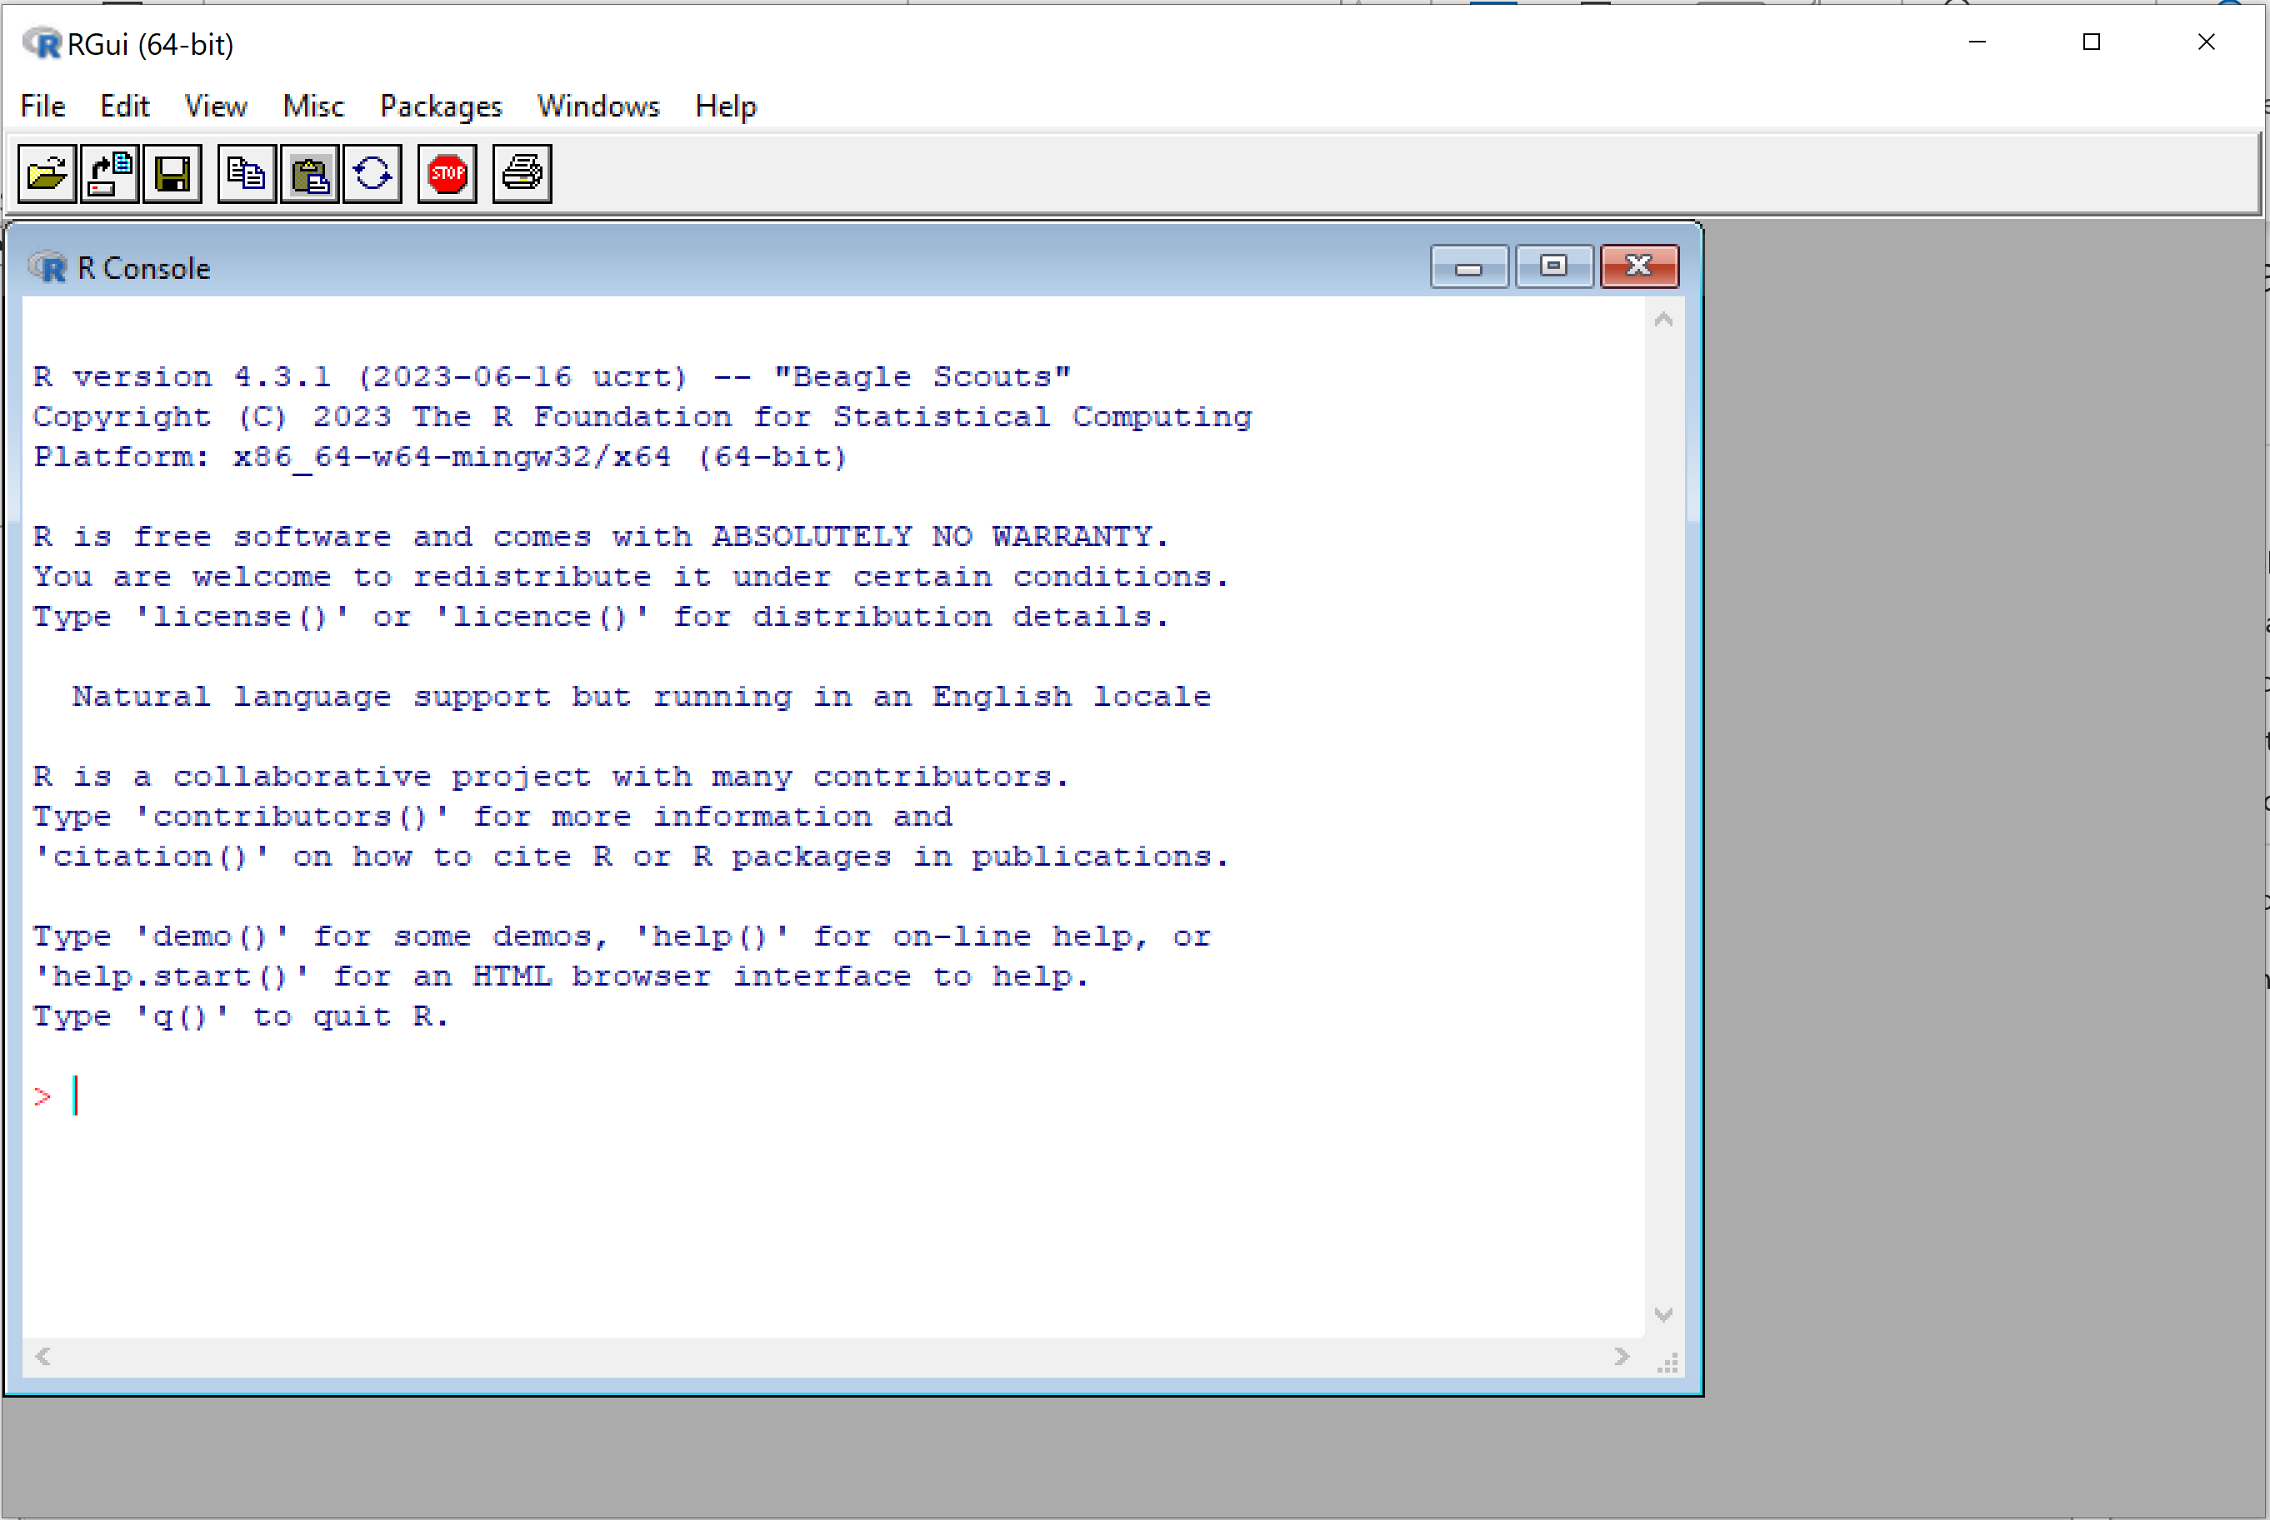
Desktop application
GUI hasn’t changed in 20+ years

Slide 12
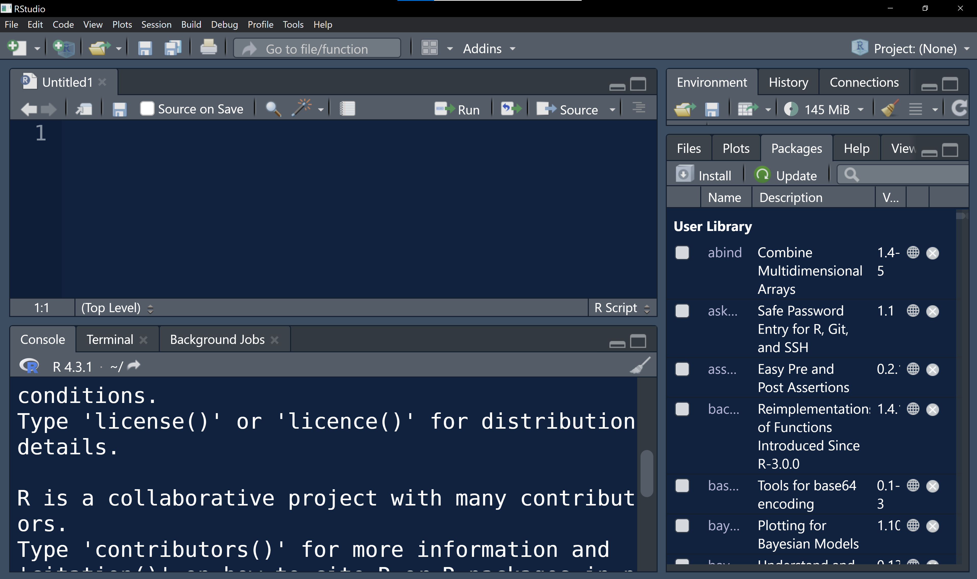
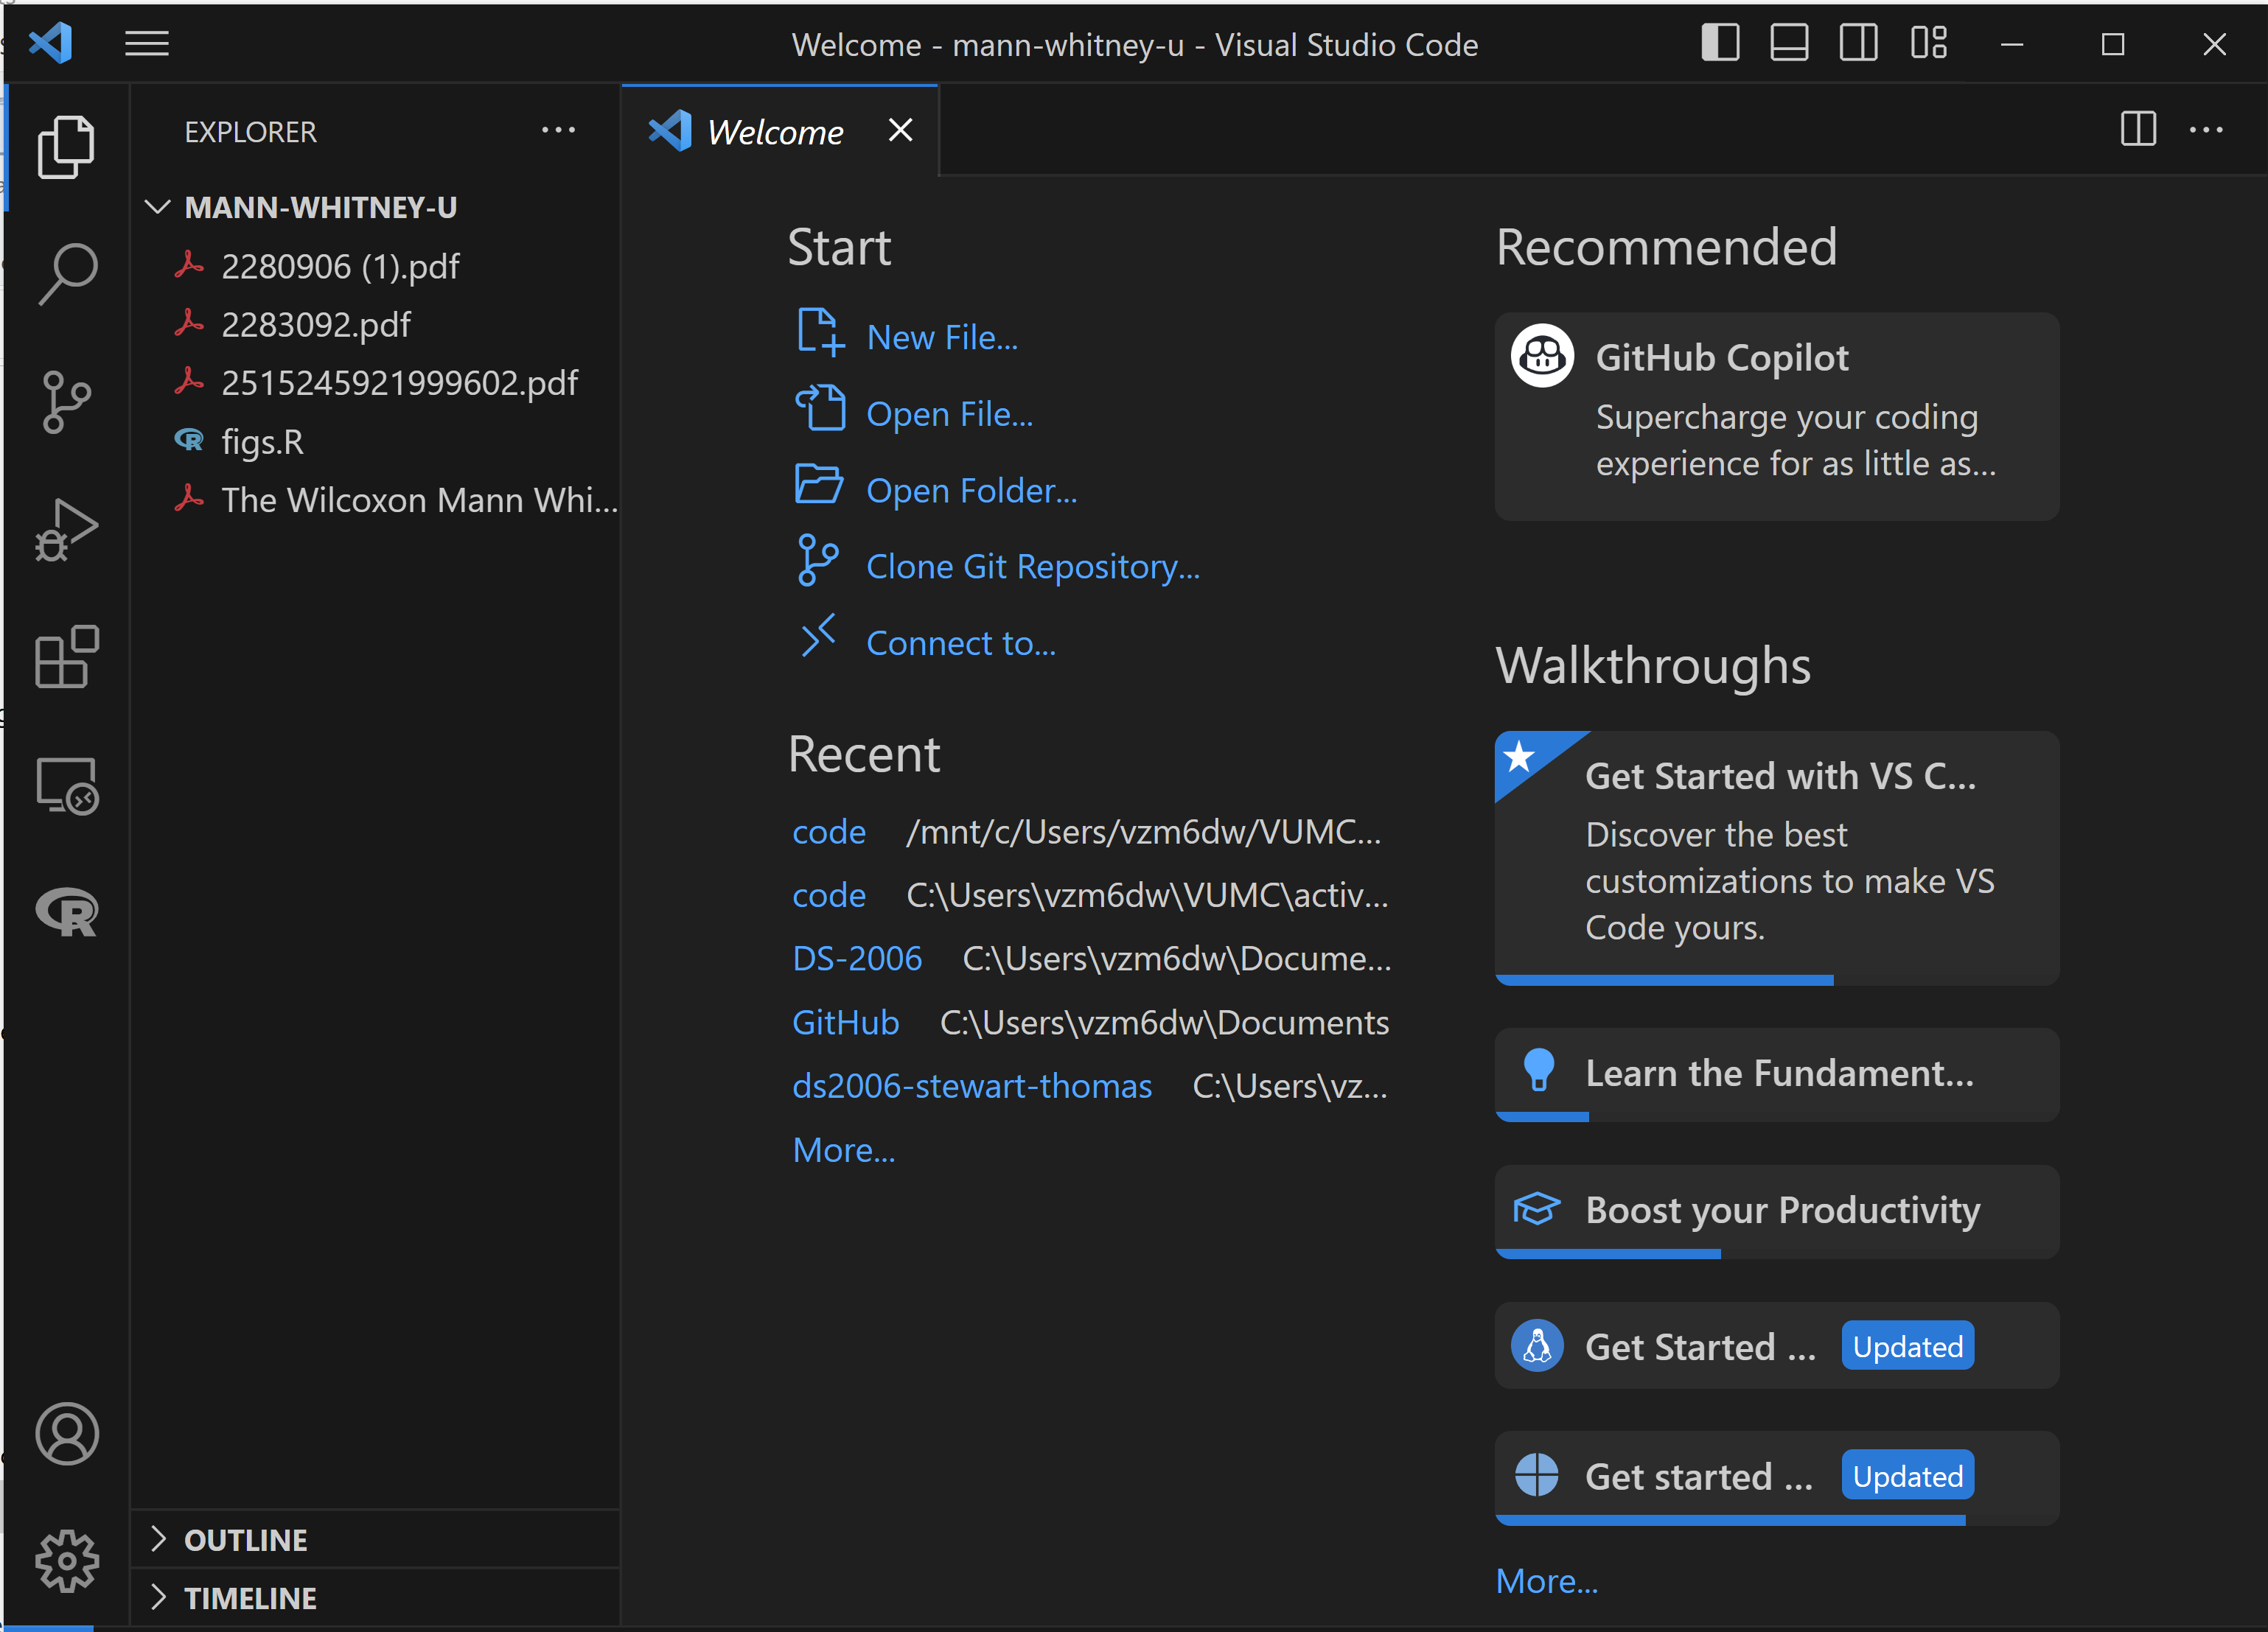
Typically paired with an IDE
Rstudio
VS Code

Slide 13
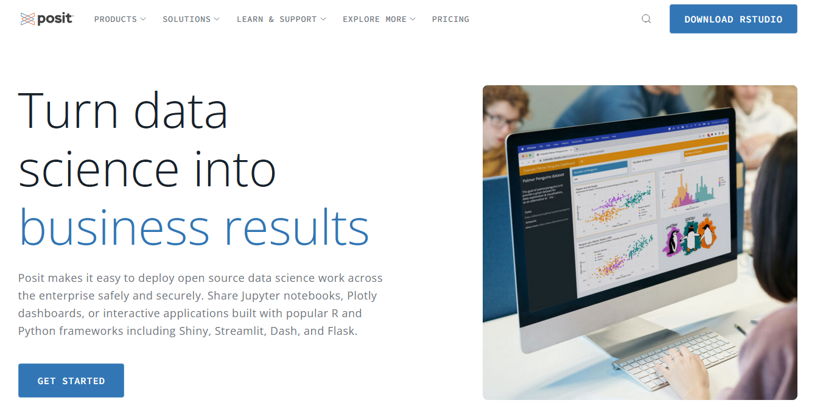
Rstudio
Web address: posit.co

Slide 14
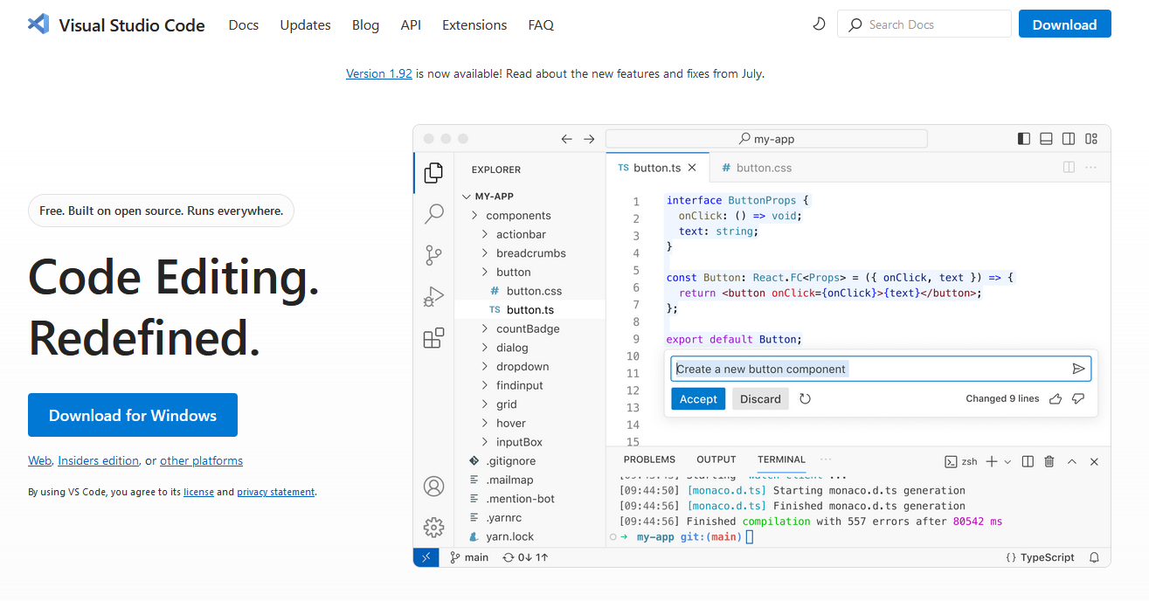
VS Code

Slide 15
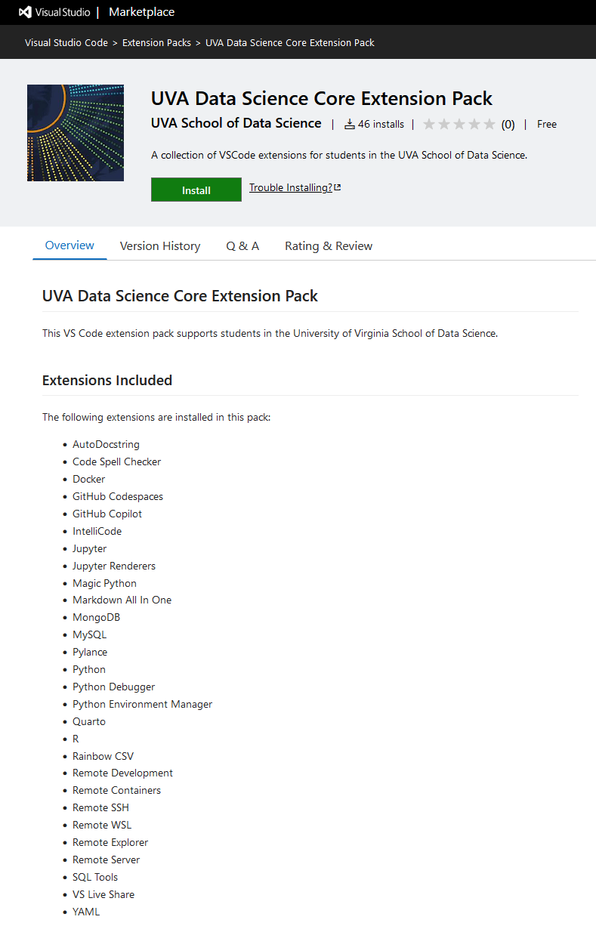
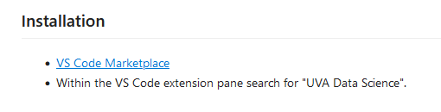
VS Code
UVA Data Science Extension Pack ready to install.

Slide 16
Turning on your computer does not endow you with know-how to complete your task.
Typically, you are better off understanding your task before you turn on your computer.

