Slide 1
Working directory and file paths

Slide 2
Folder structure for a simple project
Project A
├── code
├── data
└── docs

Slide 3
Folder structure for a several projects
Projects
├── Project A
│ ├── code
│ ├── data
│ └── docs
│
├── Project B
│ ├── code
│ ├── data
│ └── docs
│
└── Project C
├── code
├── data
└── docs

Slide 4
Larger context
Drive C
├── Memes
│ ├── classics
│ ├── animals
│ └── wholesome
│
└── Projects
├── Project A
│ ├── code
│ ├── data
│ └── docs
│
├── Project B
│ ├── code
│ ├── data
│ └── docs
│
└── Project C
├── code
├── data
└── docs

Slide 5
Larger context
Drive C
├── Memes
│ ├── classics
│ ├── animals
│ └── wholesome
│
└── Projects
├── Project A
│ ├── code
│ ├── data
│ └── docs
│
├── Project B
│ ├── code
│ ├── data
│ └── docs
│
└── Project C
├── code
├── data
└── docs
When executing a script, where does the program find the input data files?
When executing a script, where does the program save the output figures, files, and reports?

Slide 6
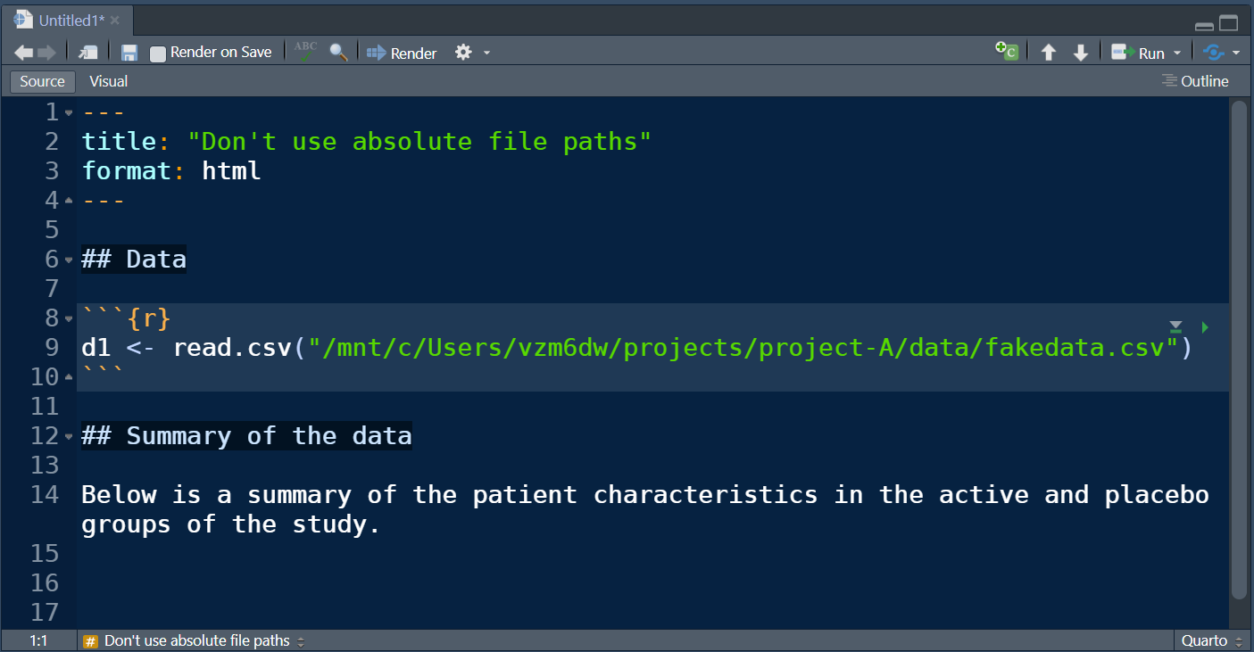
Absolute file location
Drive C
├── Memes
│ ├── classics
│ ├── animals
│ └── wholesome
│
└── Projects
├── Project A
│ ├── code
│ ├── data
│ └── docs
│
├── Project B
│ ├── code
│ ├── data
│ └── docs
│
└── Project C
├── code
├── data
└── docs
When executing a script, where does the program find the input data files?
One option is to give the exact location of the file. This is an absolute file path.

Slide 7
Absolute file location
Drive C
├── Memes
│ ├── classics
│ ├── animals
│ └── wholesome
│
└── Projects
├── Project A
│ ├── code
│ ├── data
│ └── docs
│
├── Project B
│ ├── code
│ ├── data
│ └── docs
│
└── Project C
├── code
├── data
└── docs
When executing a script, where does the program find the input data files?
One option is to give the exact location of the file. This is an absolute file path.
This is a discouraged practice because it complicates sharing your code.
Other users will have to change every file path to use the code on their machine.

Slide 8
Better practice: working directory and relative file location
Drive C
├── Memes
│ ├── classics
│ ├── animals
│ └── wholesome
│
└── Projects
├── Project A
│ ├── code
│ ├── data
│ └── docs
│
├── Project B
│ ├── code
│ ├── data
│ └── docs
│
└── Project C
├── code
├── data
└── docs
The working directory is a specially designated folder.
Unless told otherwise, the program will search for files and write files to this directory.

Slide 9
Better practice: working directory and relative file location
Drive C
├── Memes
│ ├── classics
│ ├── animals
│ └── wholesome
│
└── Projects
├── Project A
│ ├── code
│ ├── data
│ └── docs
│
├── Project B
│ ├── code
│ ├── data
│ └── docs
│
└── Project C
├── code
├── data
└── docs
Can use . and .. to navigate the file structure from the working directory.
.. means to go up one level.

Slide 10
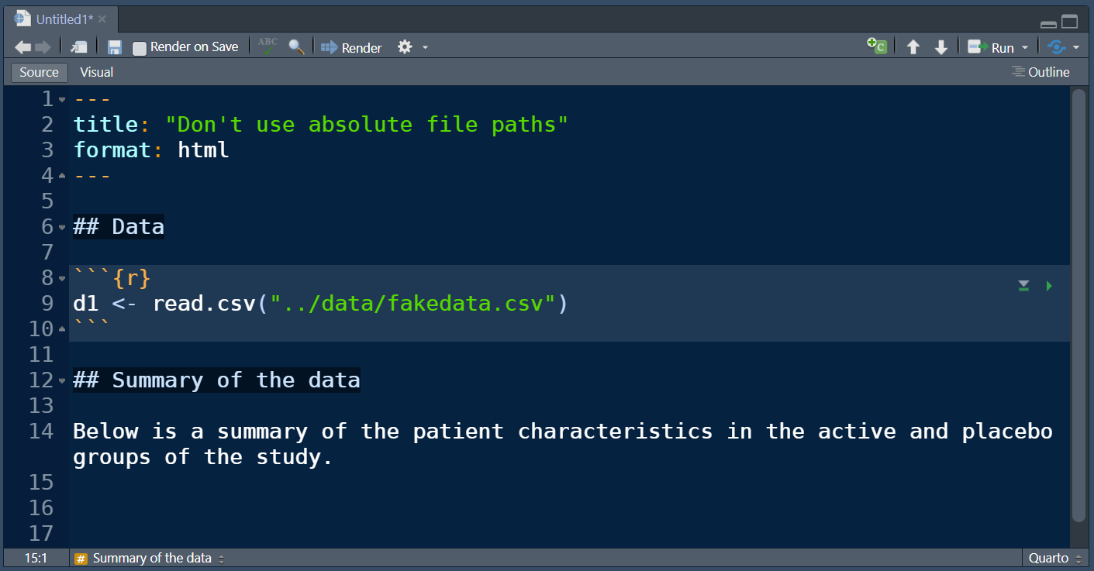
Better practice: working directory and relative file location
Drive C
├── Memes
│ ├── classics
│ ├── animals
│ └── wholesome
│
└── Projects
├── Project A
│ ├── code
│ ├── data
│ └── docs
│
├── Project B
│ ├── code
│ ├── data
│ └── docs
│
└── Project C
├── code
├── data
└── docs
Can use . and .. to navigate the file structure from the working directory.
.. means to go up one level.

Slide 11
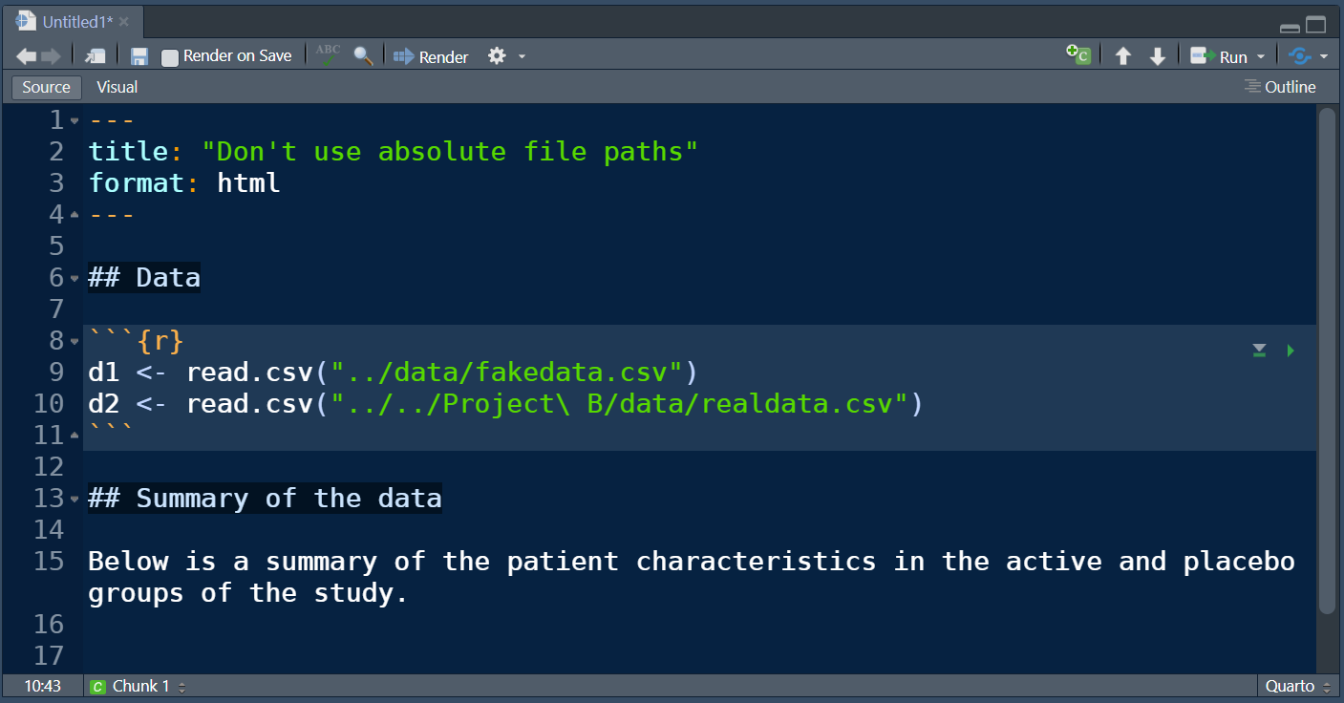
Better practice: working directory and relative file location
Drive C
├── Memes
│ ├── classics
│ ├── animals
│ └── wholesome
│
└── Projects
├── Project A
│ ├── code
│ ├── data
│ └── docs
│
├── Project B
│ ├── code
│ ├── data
│ └── docs
│
└── Project C
├── code
├── data
└── docs
Can use . and .. to navigate the file structure from the working directory.
.. means to go up one level.

Slide 12
Better practice: working directory and relative file location
Drive C
├── Memes
│ ├── classics
│ ├── animals
│ └── wholesome
│
└── Projects
├── Project A
│ ├── code
│ ├── data
│ └── docs
│
├── Project B
│ ├── code
│ ├── data
│ └── docs
│
└── Project C
├── code
├── data
└── docs
Can use . and .. to navigate the file structure from the working directory.
.. means to go up one level.
This is a better practice because the program will work on other machines so long as the projects folders are the same.

Slide 13
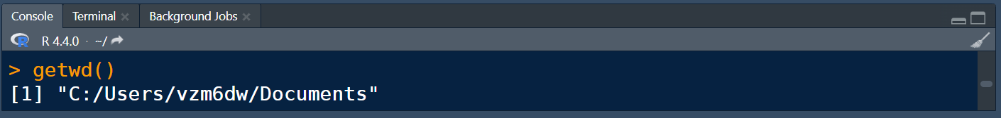
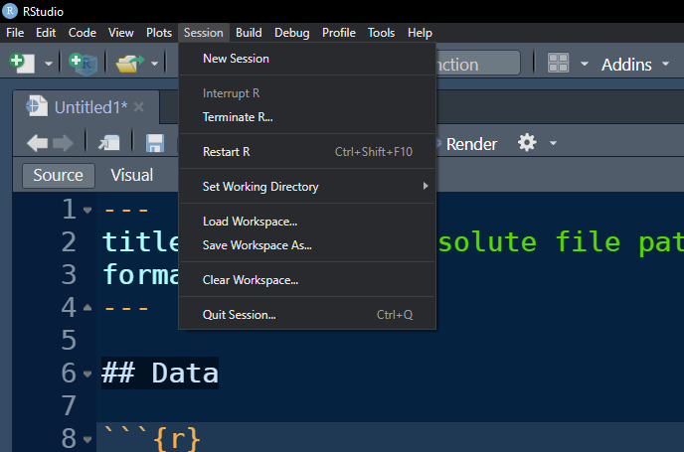
How to check and set the working directory
Drive C
├── Memes
│ ├── classics
│ ├── animals
│ └── wholesome
│
└── Projects
├── Project A
│ ├── code
│ ├── data
│ └── docs
│
├── Project B
│ ├── code
│ ├── data
│ └── docs
│
└── Project C
├── code
├── data
└── docs
Command to see working directory location
Point and click to set working directory
Another approach is `projects` which we may cover after you complete the Github module in Systems.

Slide 14
How to check and set the working directory
Drive C
├── Memes
│ ├── classics
│ ├── animals
│ └── wholesome
│
└── Projects
├── Project A
│ ├── code
│ ├── data
│ └── docs
│
├── Project B
│ ├── code
│ ├── data
│ └── docs
│
└── Project C
├── code
├── data
└── docs
The working directory is the default location for saving files, figures, and reports.

